Slide 1
Expanding the R-universe the Tidyverse, Markdown, and Git
Alejandro Ordonez
Assistant Professor - Department of Bioscience
Section for Ecoinformatics & Biodiversity
Center for Biodiversity Dynamics in a Changing World (BIOCHANGE)

Slide 2
Expanding the R-universe What we will talk about today
Welcome to the Tidyverse – Unifying design philosophy, grammar, and data structures
Documenting and communicating your work – Creating reproducible reports.
Version control – Keeping track of your work and facilitate collaboration

Slide 3
Any questions?
Ready to start?

Slide 4


What is the Tidyverse
Hadley Wickham
Chief Scientist at Posit
The tidyverse is a collection of R packages sharing an underlying design philosophy, grammar, and data structures.
Check the The tidy tools manifesto
https://bit.ly/3XziyYO

Slide 5
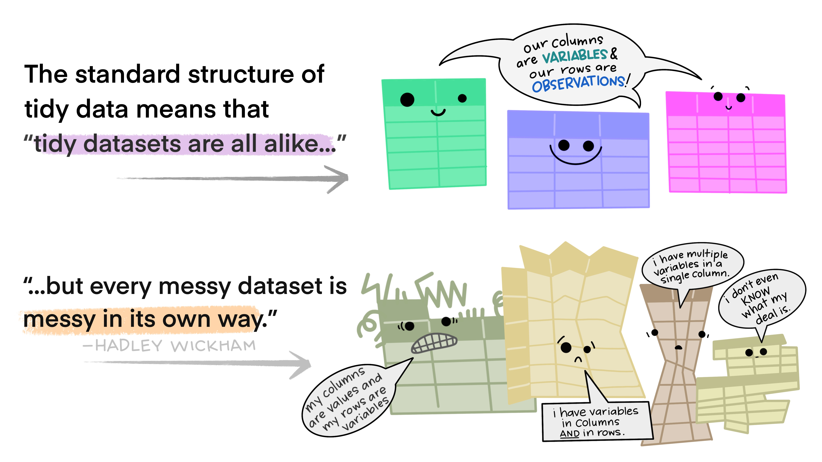
The tidyverse philosophy
At the core of the tidyverse philosophy is addressing the issue of messy data
Illustration from:
Allison Horst https://allisonhorst.com/

Slide 6
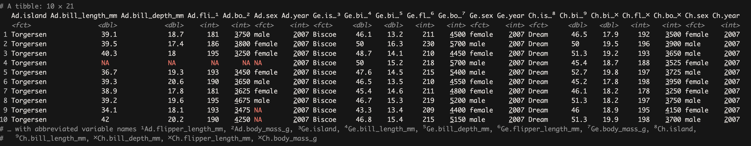
How does untidy data look like
Each column is a combination of two variables
Species X Variable

Slide 7
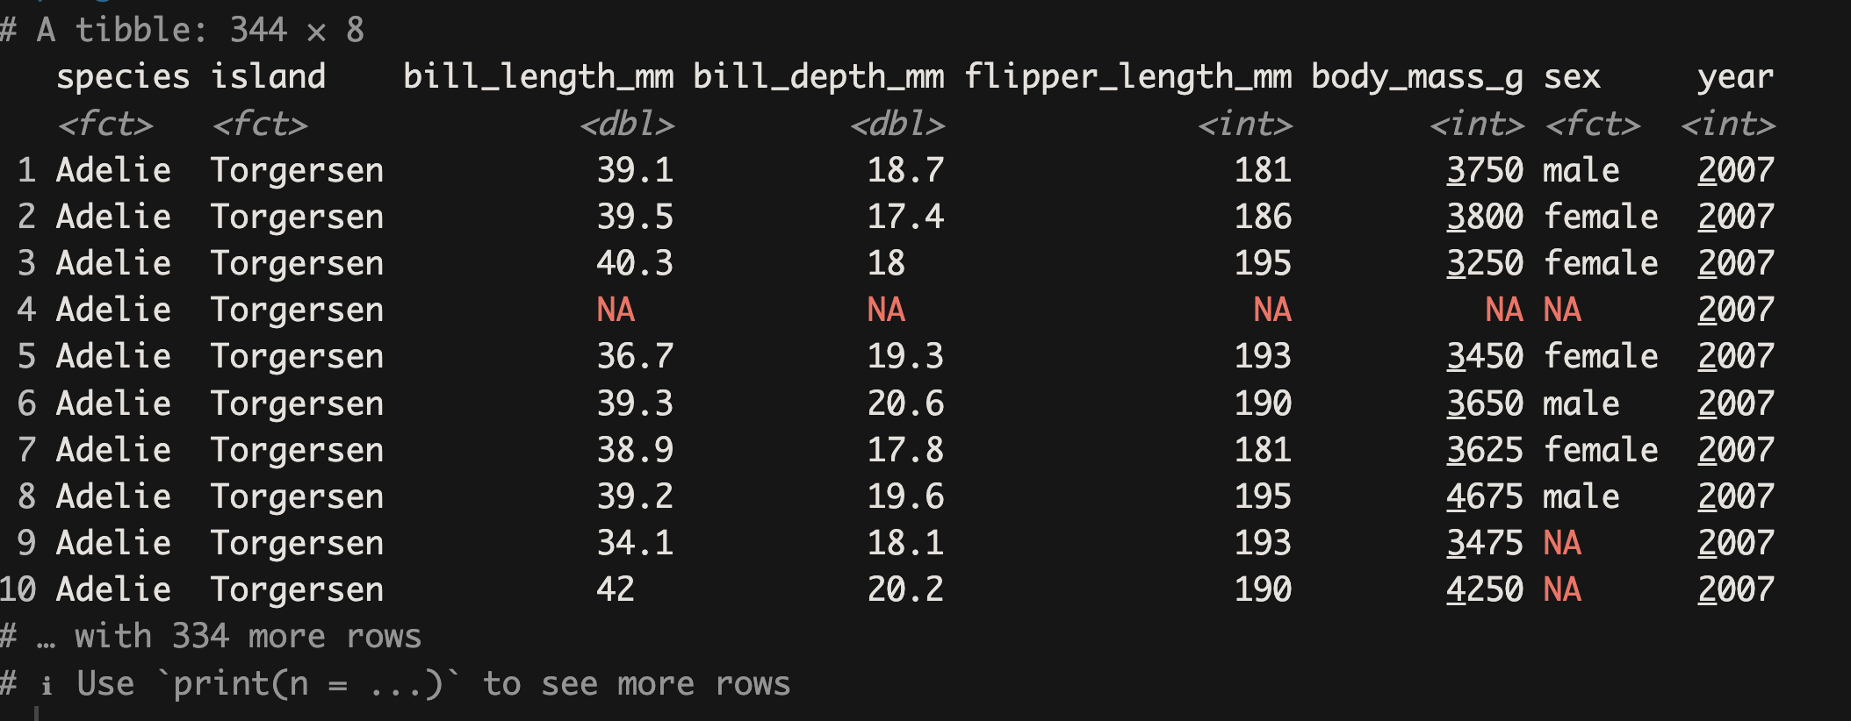
How does tidy data look like
Each column is unique variable

Slide 8

Tidy Data the core of the tidyverse
Illustration from:
Allison Horst https://allisonhorst.com/

Slide 9
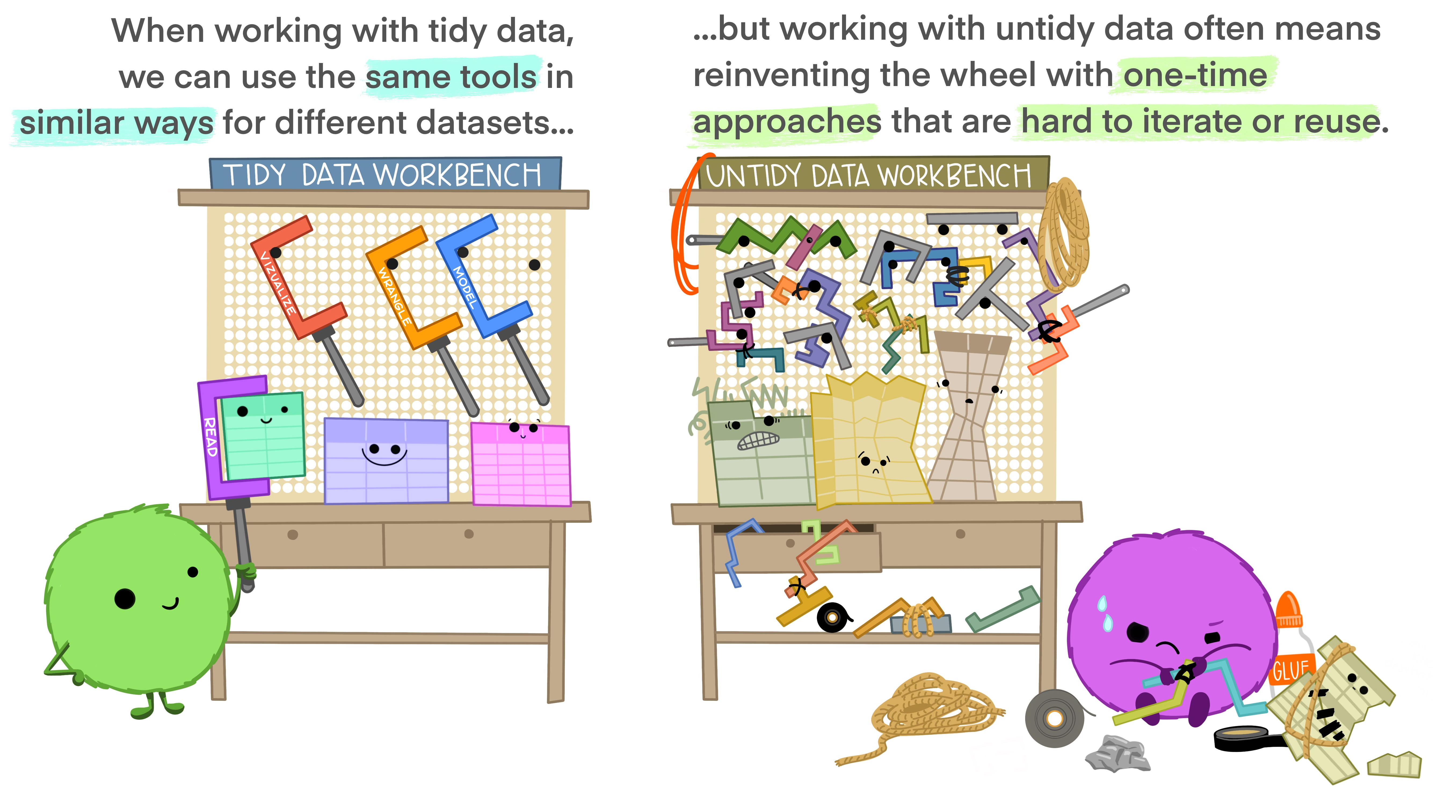
Why Tidy data
Illustration from:
Allison Horst https://allisonhorst.com/

Slide 10
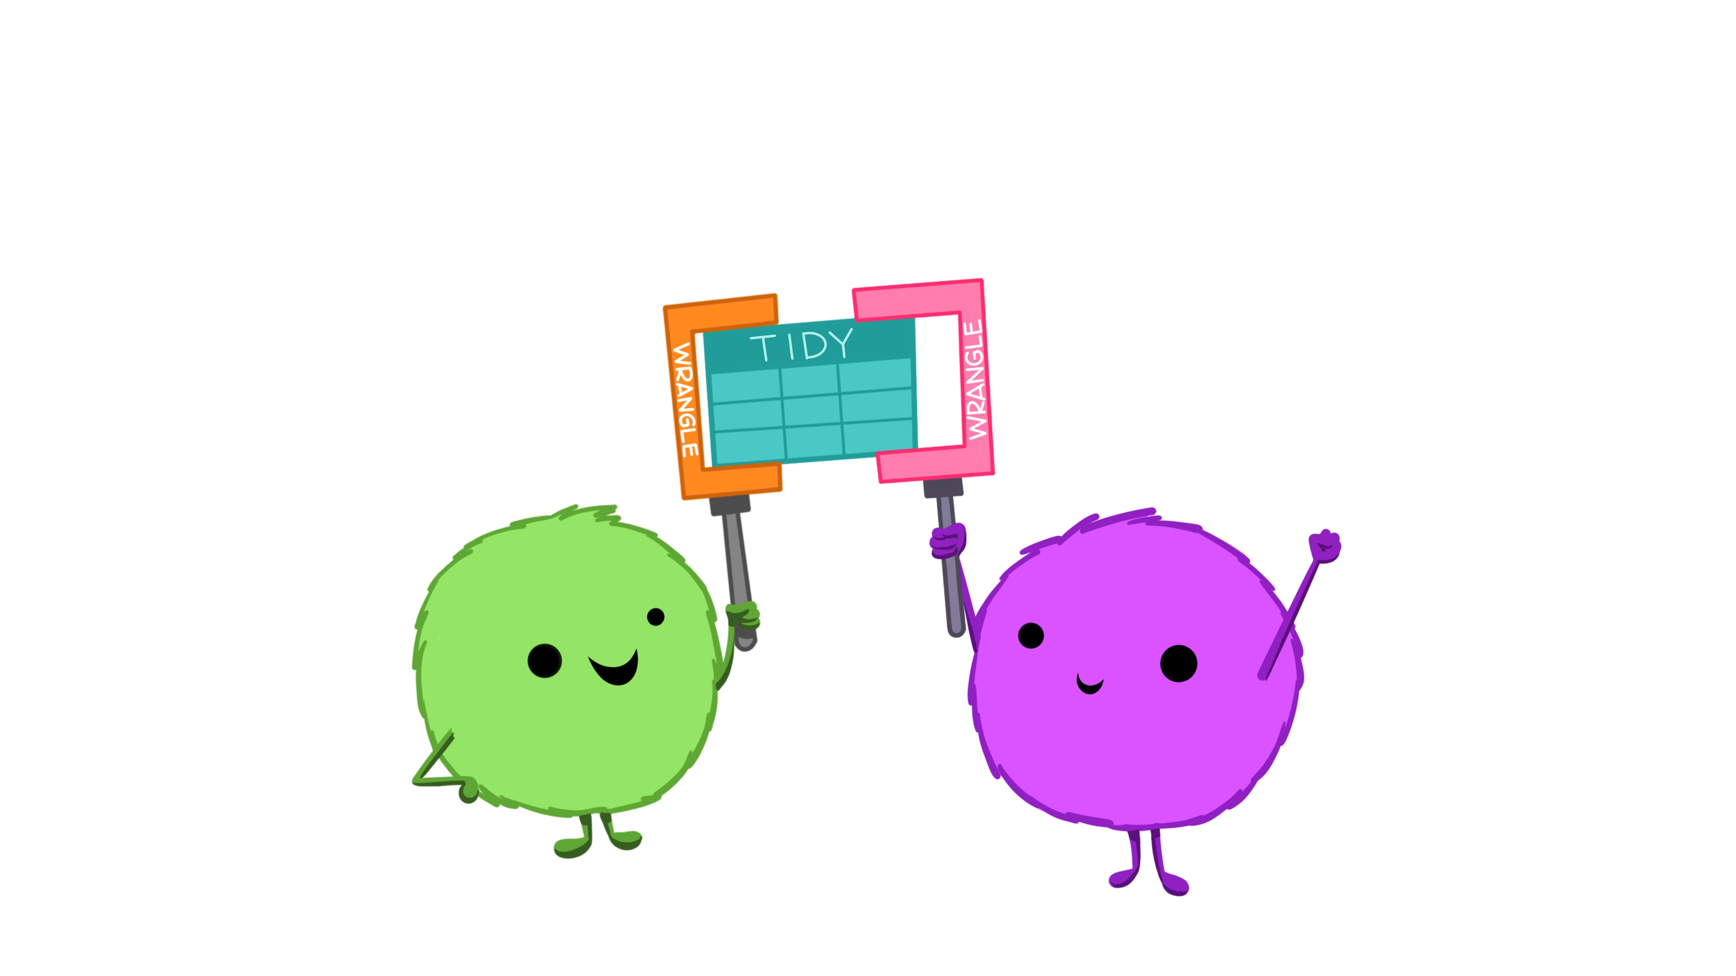
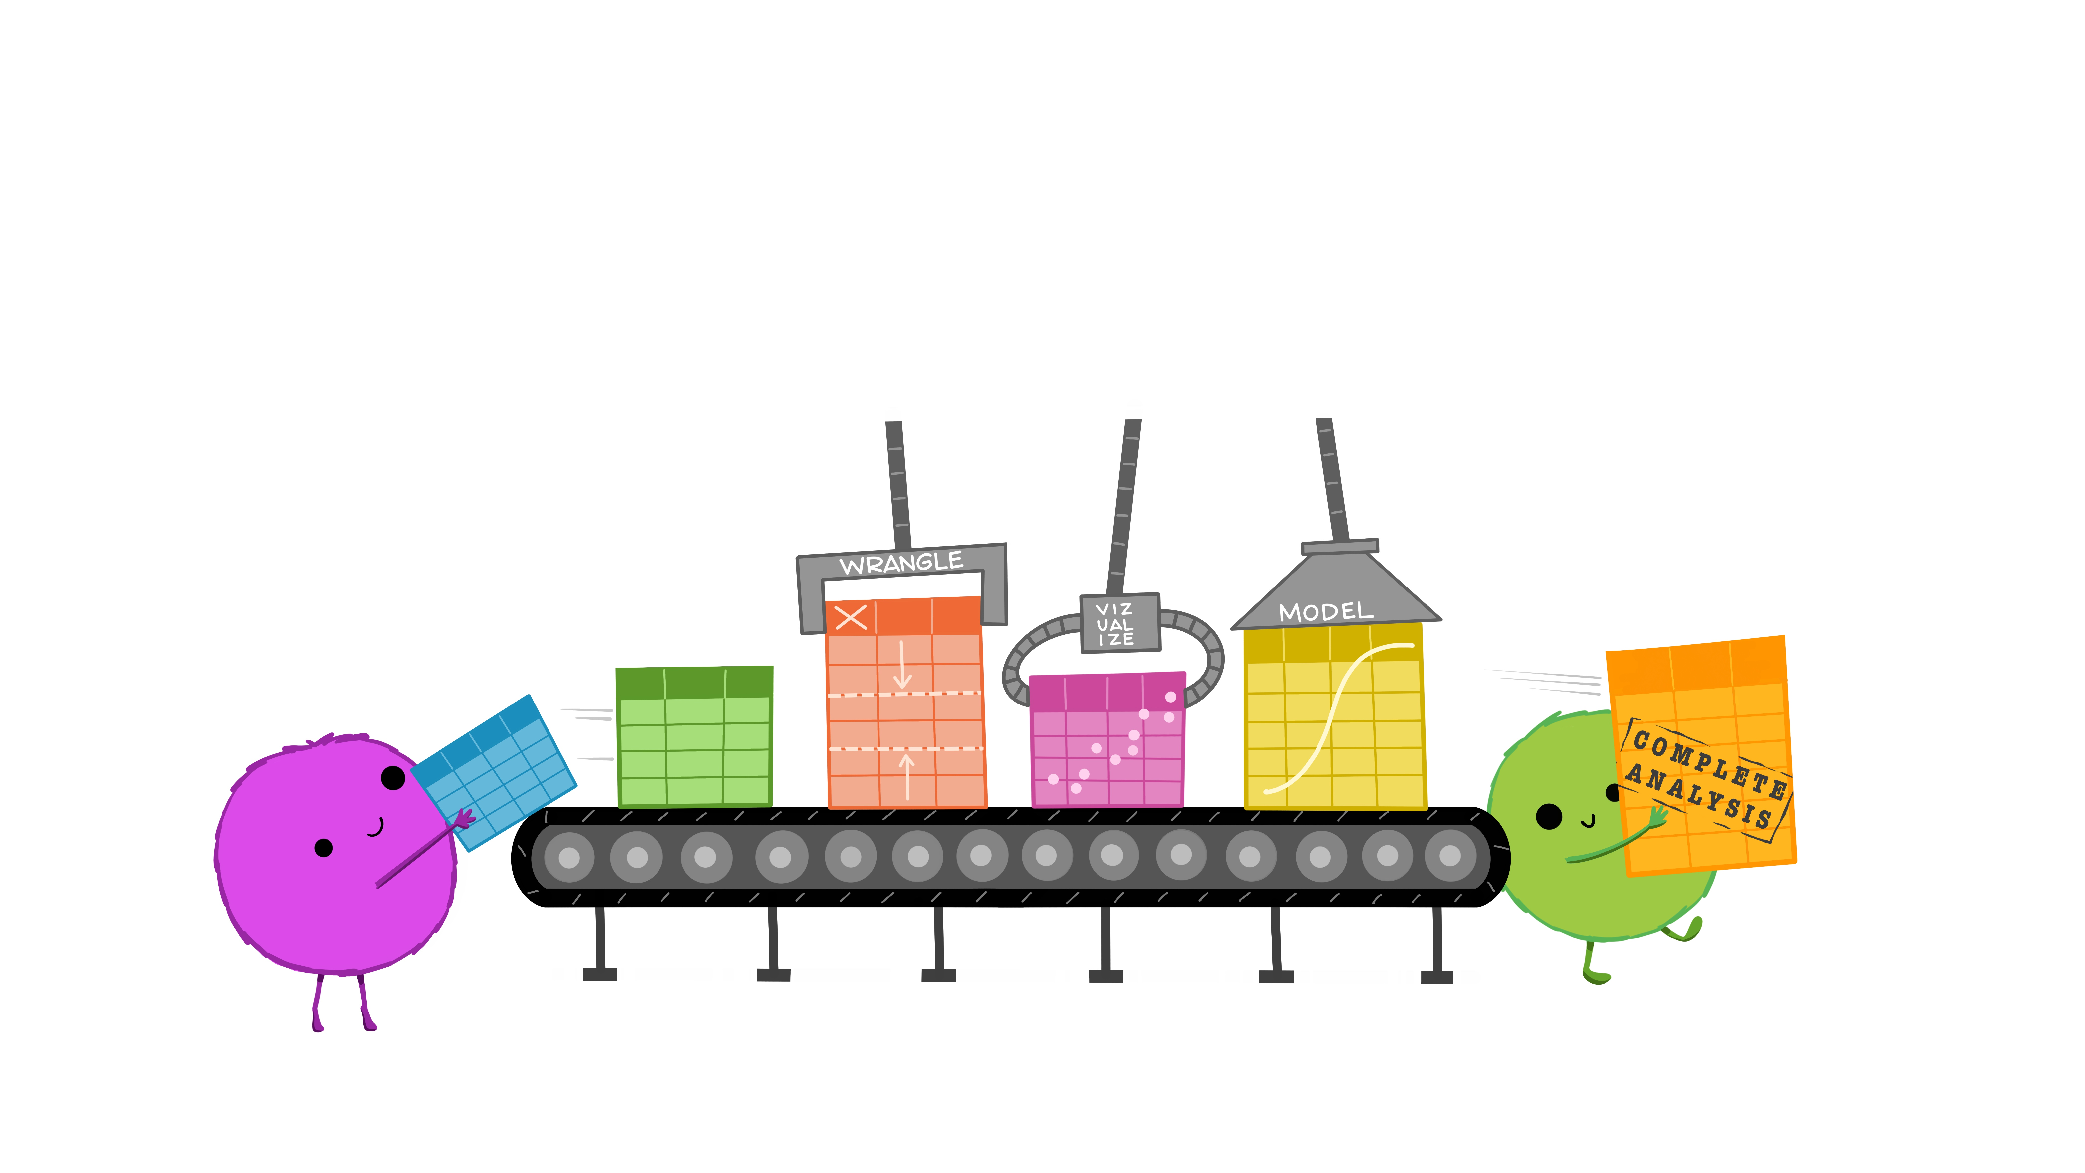
Why Tidy data?
Easier collaboration
Reproducibility and reuse
Illustrations from:
Allison Horst https://allisonhorst.com/

Slide 11
So far so good?
Any questions?
Ready to continue?

Slide 12
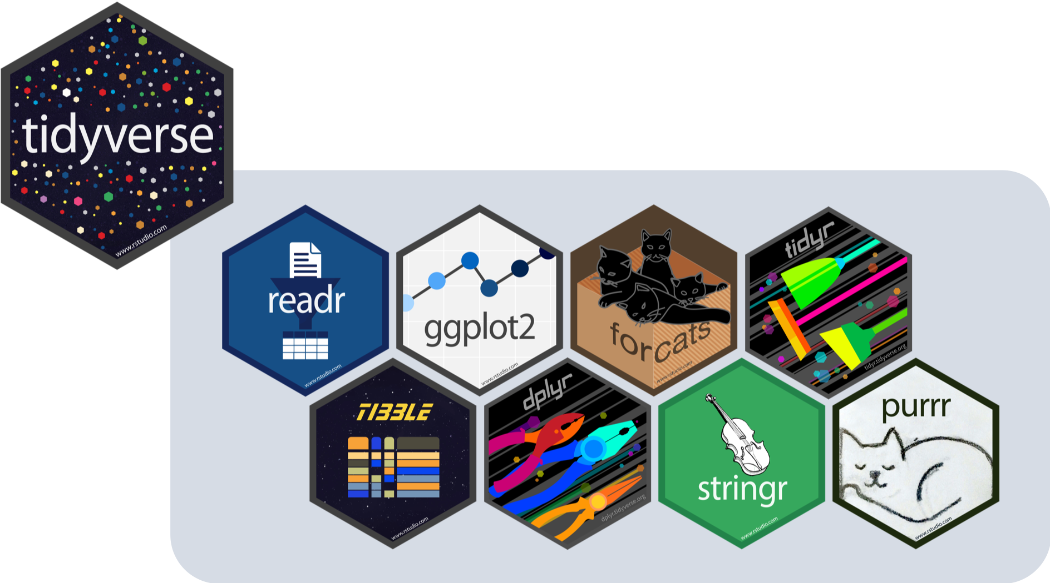
What is in the Tidyverse
These packages are…
Build on the tidy data structure.
Focused on the use of functions that can be considered as verbs.
Link these functions with the use of pipe(s).
From the “The tidy tools manifesto”
https://bit.ly/3XziyYO

Slide 13
What is in the Tidyverse
Plotting
Working with ”factors”
Make Data “Tidy”
Read data and putting it in a “Tidy” setup
Functional programming
Make data.frames “Tidy”
Data manipulation
Working with ”strings”

Slide 14


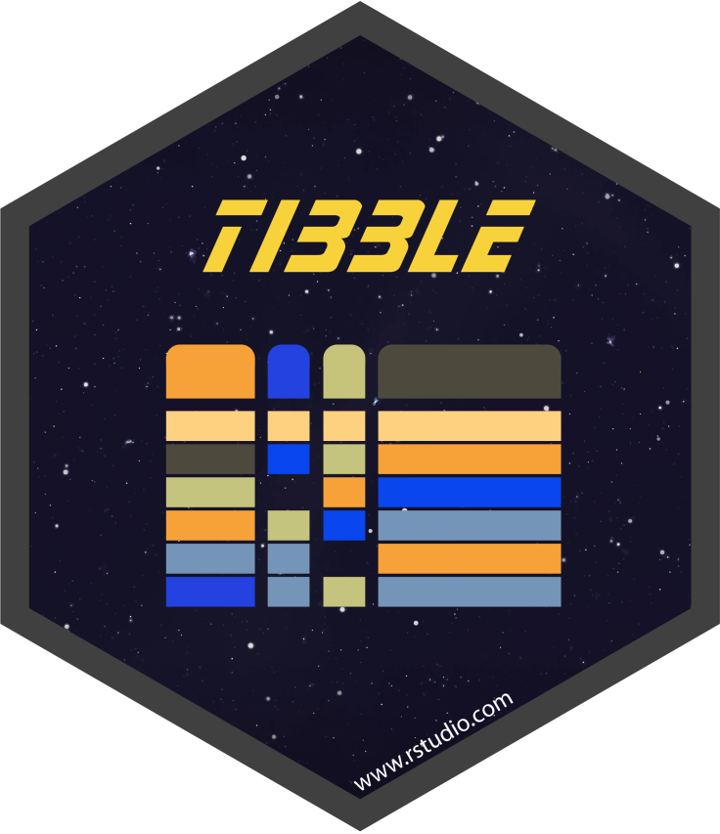
Working with tables Readr, TidyR, & TIBBLE
The tidyverse philosophy is build
on the principle of “tidy data”!
What is tidy data?
A way to describe data that’s organized with a particular structure.
A rectangular structure, where...
Each variable has its own column.
Each observation has its own row.
Each cell has its own row.
Wickham, H (2014). Tidy Data. Journal of Statistical Software 58 (10). jstatsoft.org/v59/i10/

Slide 15
Working with tables tidyR
The goal of tidyr is to help you create tidy data stored as tibbles.
tibbles : This is a Table.
tibbles are a object class (remember two weeks ago?) that..
Have a refined print method that shows only the first 10 rows
No partial matching → full names!!
Provide concise views of the data on one screen
Remember!! Tidy data describes a standard way of storing data that is used wherever possible throughout the tidyverse.

Slide 16
How does a tibble Look like?
penguin[,1:5]
# A tibble: 344 × 5
...1 species island bill_length_mm bill_depth_mm
<dbl> <chr> <chr> <dbl> <dbl>
1 1 Adelie Torgersen 39.1 18.7
2 2 Adelie Torgersen 39.5 17.4
3 3 Adelie Torgersen 40.3 18
4 4 Adelie Torgersen NA NA
5 5 Adelie Torgersen 36.7 19.3
# … with 339 more rows
# Use `print(n = ...)` to see more rows
Variable Names
Variable Class
Observation
Value
Variable

Slide 17

Working with tibbles
#printing Tibbles
penguins #standard
print(penguins, n=4) #Change the number of rows
print(penguins, max_extra_cols=4) #abbreviated variable names
# if they don't fit
# Sub-setting tibbles - by variable
penguins[,"species"] # returns a tibble
penguins[,"species", drop=TRUE] # forcing it to be a Vector
penguins$species # returns a vector
# Accessing non-existent variable:
penguins$bill_width_mm
# Sub-setting tibbles - by Observation
penguins[1, ] # Returns a tibble

Slide 18
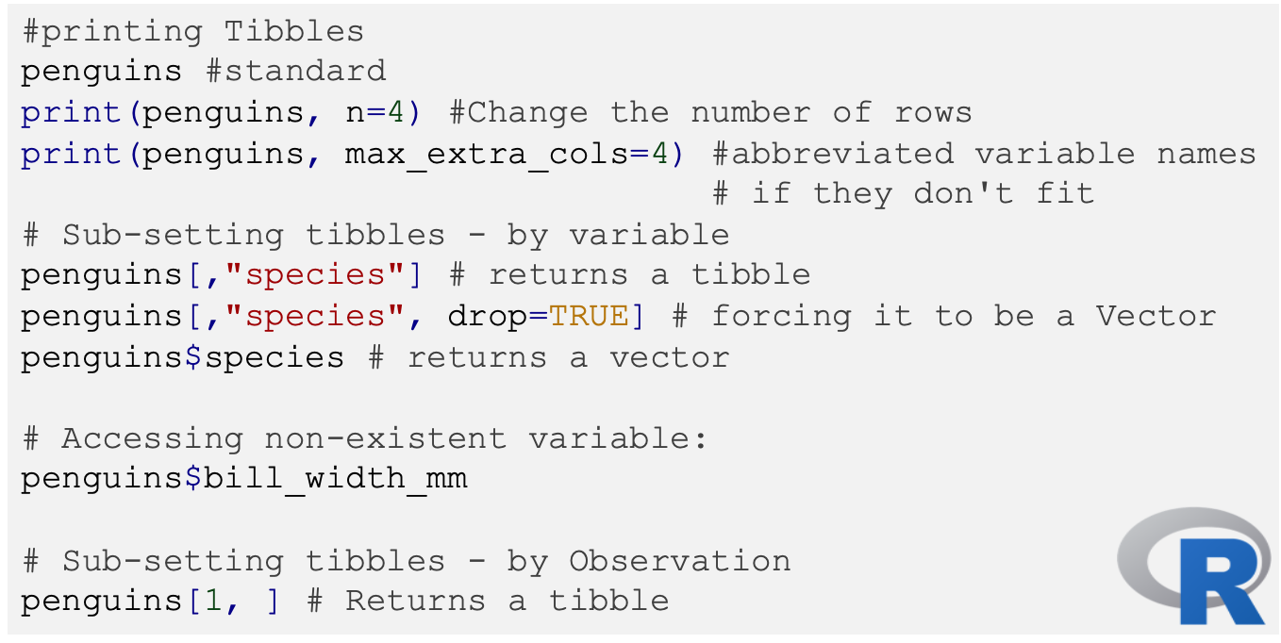
Working with tibbles

Slide 19
Working with tables Readr
Fast and friendly way to read rectangular data from delimited files:
Comma-separated values (CSV) [read_csv() read_csv2()]
Tab-separated values (TSV) [read_tsv() read_delim()]
Fixed width files (FWF) [read_fwf()]
Why not read.csv()?
Better for large files (up to 10x times faster).
They don’t convert character vectors to factors.
Operation system agnostic.
In the tidyverse all datasets are read as tibbles!!
Wickham, H (2014). Tidy Data. Journal of Statistical Software 58 (10). jstatsoft.org/v59/i10/

Slide 20
Working with tables Readr
# Read the penguin Data
penguin <- read_csv("penguins.csv")
# Supply an inline csv file
### Note that there are no end comas
read_csv("species,island,bill_length_mm
Adelie, Torgersen,39.1
Adelie, Dream,43.2")
# What about if there are no column names?
read_csv("Adelie, Torgersen,39.1\nAdelie, Dream,43.2",
col_names = FALSE)
# Pass the names
read_csv("Adelie, Torgersen,39.1\nAdelie, Dream,43.2",
col_names = c("species","island","bill_length_m"))
The \n notation means pass to next line

Slide 21
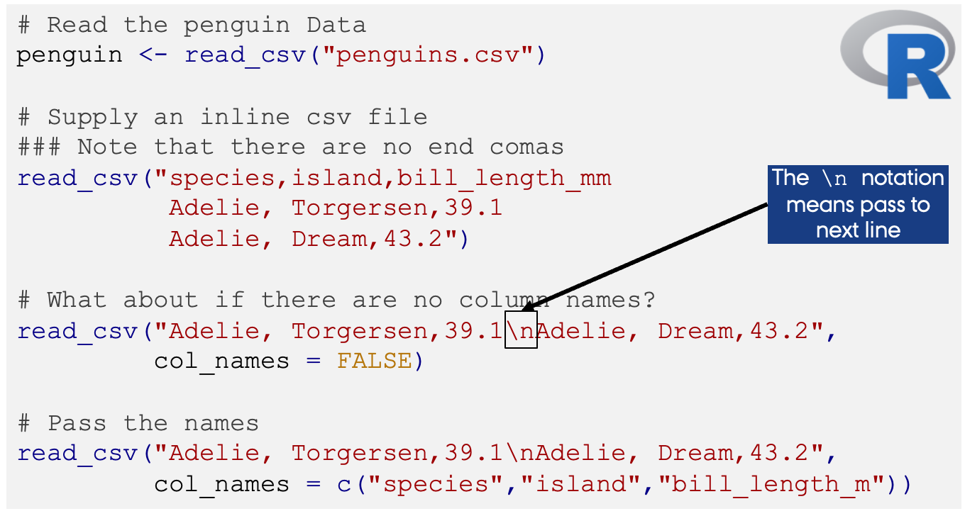
Working with tables Readr

Slide 22

Dplyr (Data - Pliers)
Grammar of data manipulation, providing a consistent set of verbs (functions) that help you solve the most common data manipulation challenges:
Add new variables that are functions of existing variables [mutate()].
Pick variables based on their names [select()].
Pick cases based on their values [filter()].
Reduces multiple values down to a single summary [summarise()].
Changes the ordering of the observations [arrange()].
These verbs can executed on groups of your data
[by combining it with the group_by() function]

Slide 23
Dplyr (Data - Pliers)
Advanced verbs
Extract a single column as a vector [pull()]
Count a group size [n()/count() ]
Alternative view of the data with one var per row [glimpse() ].
Summarise multiple columns at once [sumarize_at() ].
Transform multiple columns [mutate_at() ].

Slide 24
Dplyr (Some Examples-2)
# Generate a new variable
mutate(penguins, LenDepRto = (bill_length_mm/bill_depth_mm))
# select a section of a dataset
select(penguins, species, body_mass_g)
# Filter by a Variable
filter(penguins, species == "Adelie")
# Summarise
summarise(penguins,
n = n(),
qs = quantile(body_mass_g, c(0.25, 0.75), na.rm=T),
prob = c(0.25, 0.75))
# Arrange High to Low
arrange(penguins, desc(body_mass_g))

Slide 25
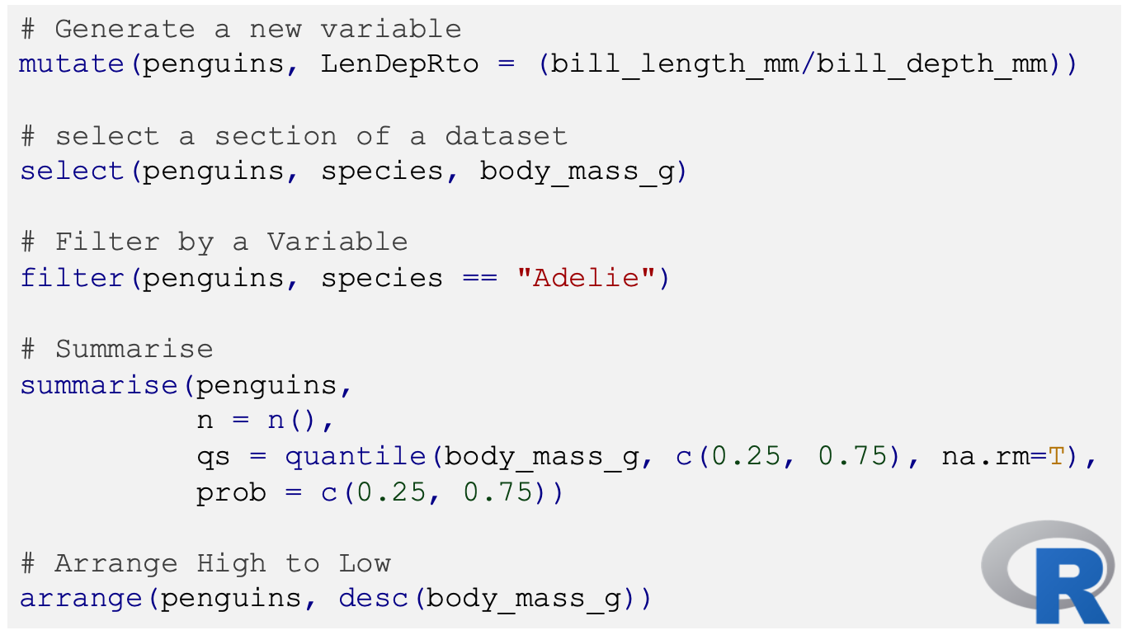
Dplyr (Some Examples-2)

Slide 26
Piping [%>%] a feature of the tidyverse grammar
The workflow in the tidyverse is focused on a sequence of actions to an single object.
Reserve pipes for sequences applied to a primary object.
This sequence of actions is defined by the pipe [%>%] operator.
penguins %>%
group_by(species) %>%
summarise(
bill_length_mm = mean(bill_length_mm,
na.rm=T),
bill_depth_mm = mean(bill_depth_mm,
na.rm=T),
species = n_distinct(species)
)
-------------------------------------------------------------------
This sequence of events can be read as:
Take penguins
AND THEN split by species
AND THEN generate summaries

Slide 27
Challenge Time!!
Using the penguins data find:
Penguins from Dream Island.
All penguins between 4Kg and 5Kg [hint use the between() function].
How many Gentoo penguins have a missing sex data.
Sort the penguins data so that
Penguins with NO body_mass_g (that is NA values) measures are the first.
Penguins the largest bill_length_mm are the first.
3. Create a new variable:
Ratio between body_mass_g and bill_length_mm
Standardized body_mass_g

Slide 28
Solution

Slide 29
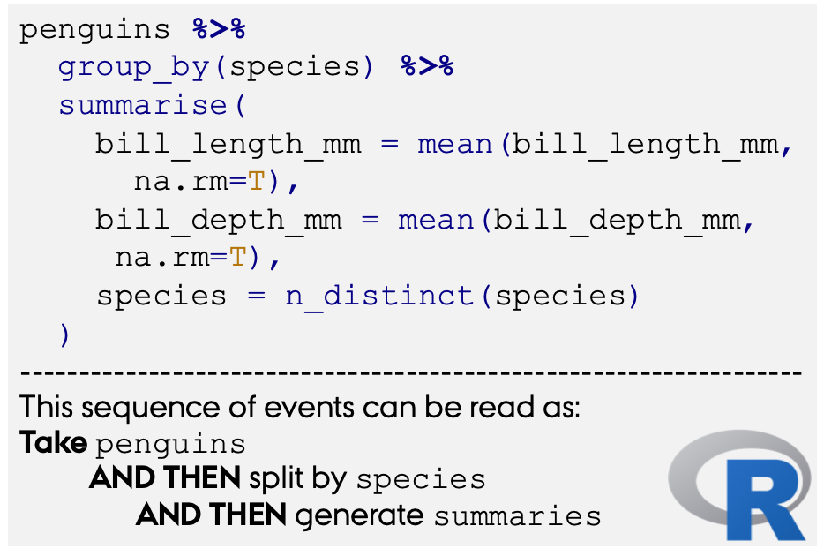
Piping [%>%] a feature of the tidyverse grammar
The workflow in the tidyverse is focused on a sequence of actions to an single object.
Reserve pipes for sequences applied to a primary object.
This sequence of actions is defined by the pipe [%>%] operator.

Slide 30
tidyR and pipes
# Sub-setting with the piping philosophy
penguins %>% .$species # returns a vector
penguins %>% .[["species"]] # returns a vector
# select a section of a dataset
penguins %>% select(species, body_mass_g)
# Filter by a Variable
penguins %>% filter(species == "Adelie")

Slide 31
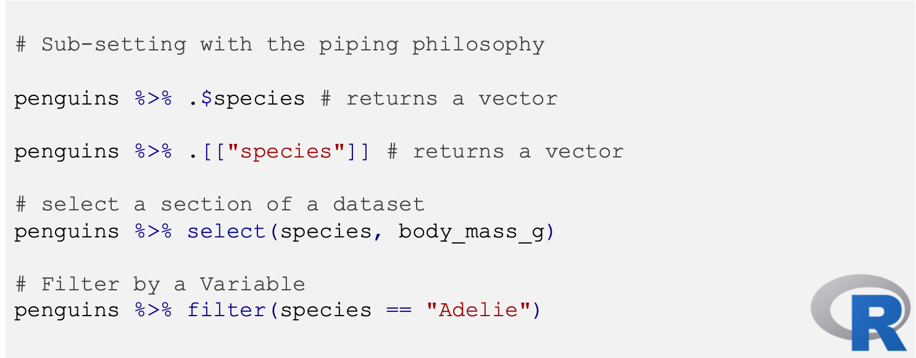
tidyR and pipes

Slide 32
Dplyr and pipes
# Generate a new variable
penguins %>%
mutate(penguins, LenDepRto = (bill_length_mm/bill_depth_mm))
# Summarise
penguins %>%
group_by (species) %>%
summarise(n = n(),
mean = mean(body_mass_g, na.rm = TRUE))
penguins %>% summarise(qs = quantile(body_mass_g,
c(0.25, 0.75),
na.rm=T),
prob = c(0.25, 0.75))
# Arrange High to Low
penguins %>%
arrange(desc(body_mass_g))

Slide 33
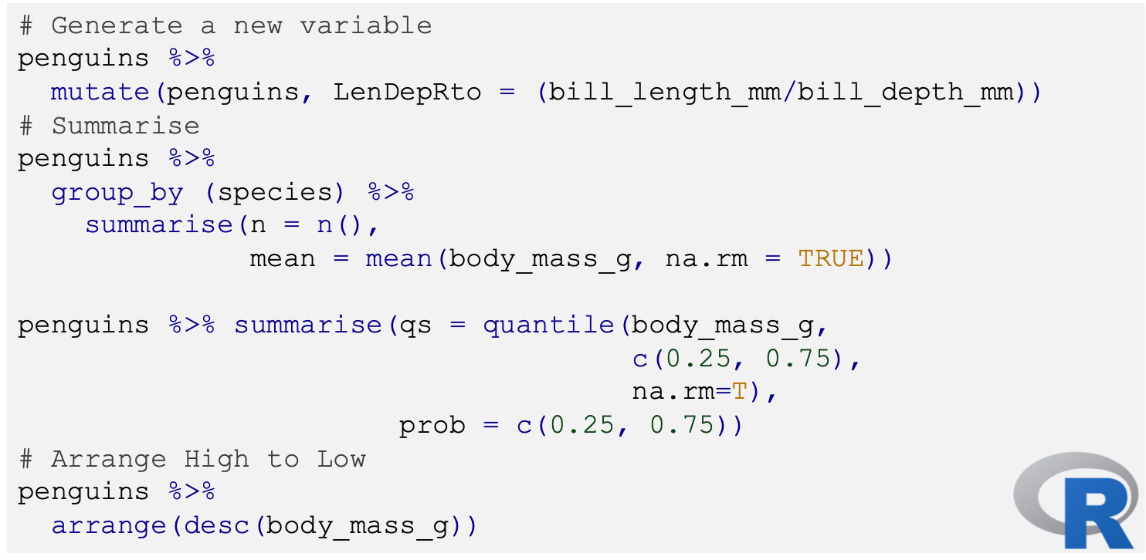
Dplyr and pipes

Slide 34

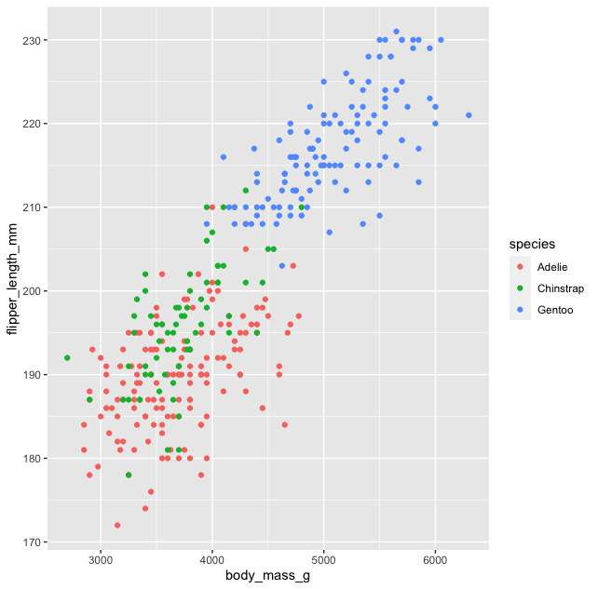
gplot2
ggplot2 is a system for declaratively creating graphics, based on The Grammar of Graphics.
You have already used this but a refresher of the dynamics:
You provide the data.
Tell ggplot2 how to map variables to aesthetics.
Define the what graphical primitives to use.
Layer in other components/figures.
ggplot(penguins,
aes(body_mass_g,
flipper_length_mm,
colour = species)) +
geom_point()

Slide 35
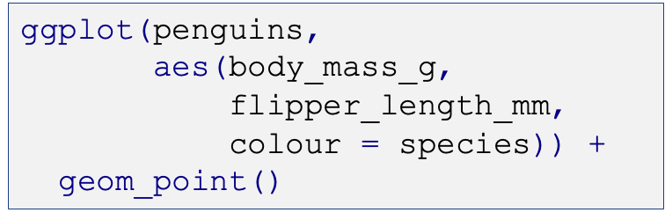
gplot2
ggplot2 is a system for declaratively creating graphics, based on The Grammar of Graphics.
You have already used this but a refresher of the dynamics:
You provide the data.
Tell ggplot2 how to map variables to aesthetics.
Define the what graphical primitives to use.
Layer in other components/figures.

Slide 36
Some notes on style…
While not necessary it is recommended to work in a homogeneous, uniform, legible and clear way when writing scripts.
The tidyverse has its own Style guide - https://style.tidyverse.org/.
The most important recommendations are:
Keep it to 80 characters per line.
Always use a space
After a comma.
Before AND after operators
==, +, -, <-,%>%
No space between the name of a function and the first parenthesis, nor between the last argument and the final parenthesis of a function.`
Avoid reusing names of functions and common variables.
Sort the script separating the parts with the comment form # Import data -----
Avoid accent marks or special symbols in names, files, routes, etc.
Object names must follow a constant structure: day_one OR day_1.

Slide 37
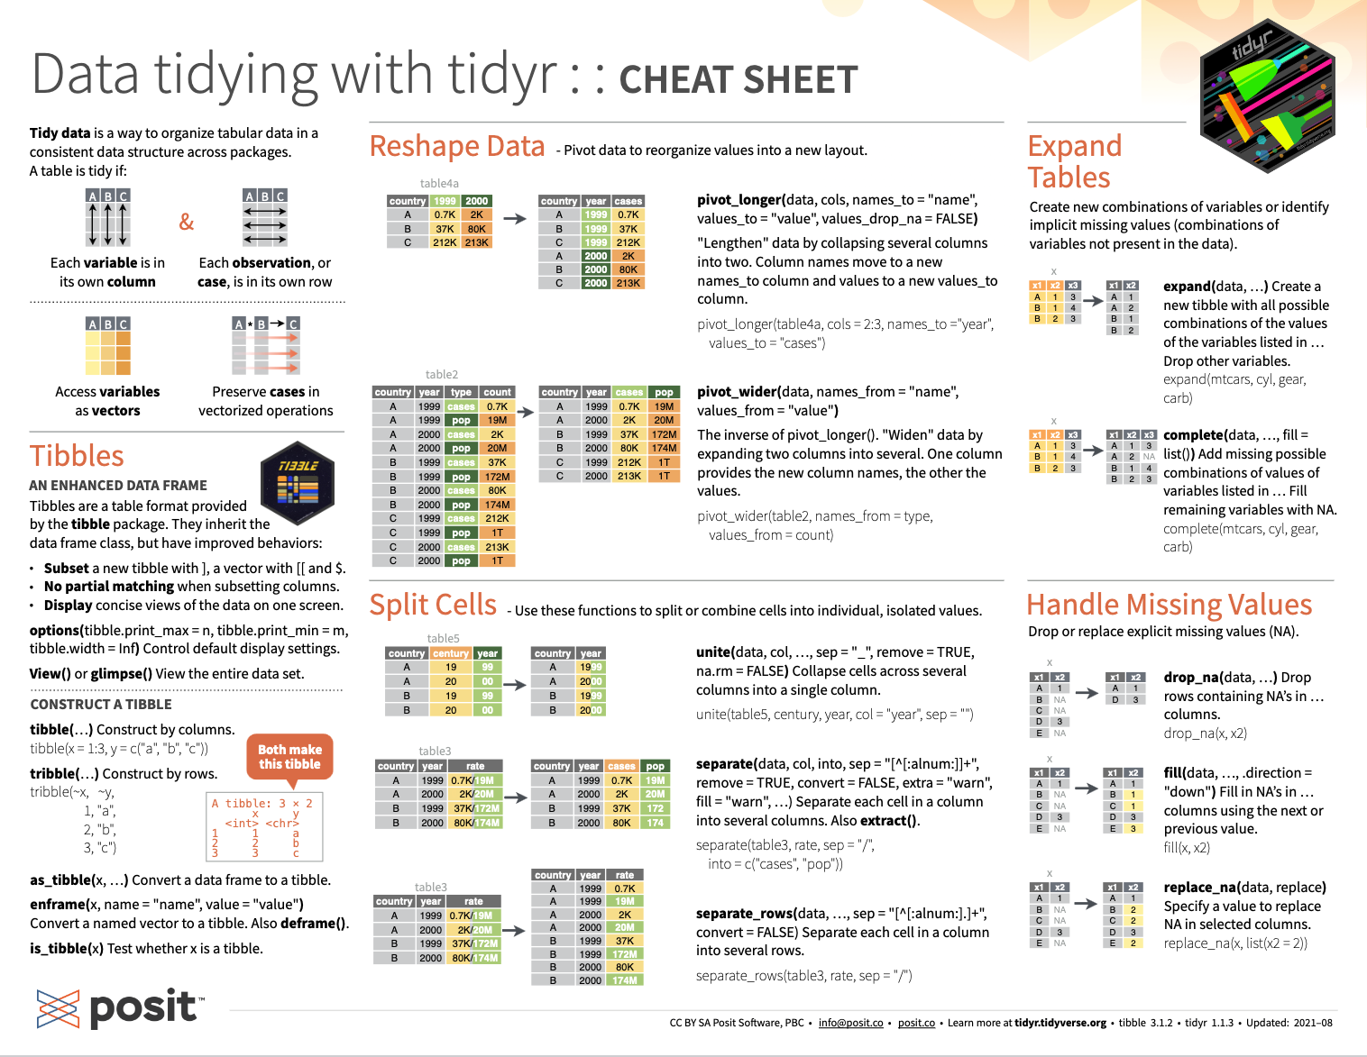
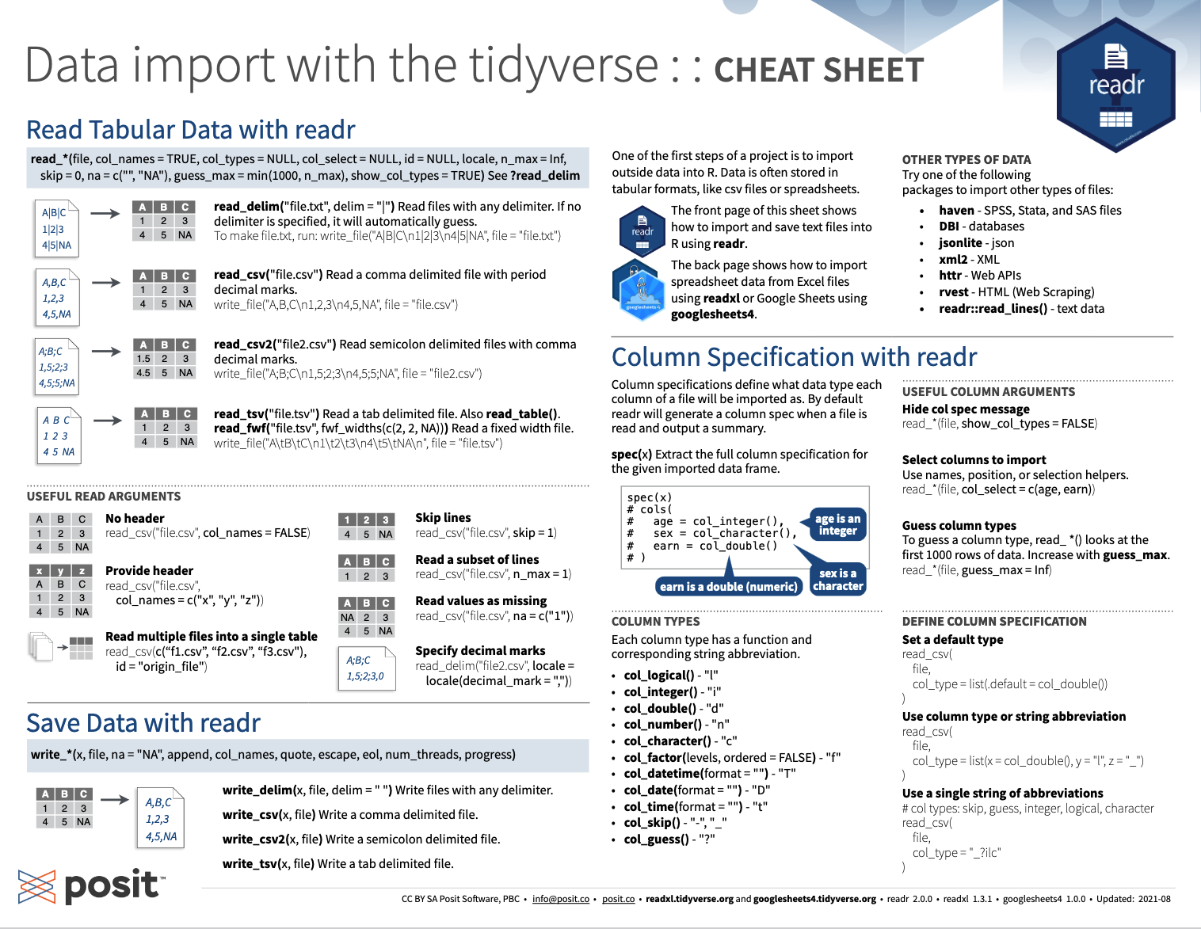
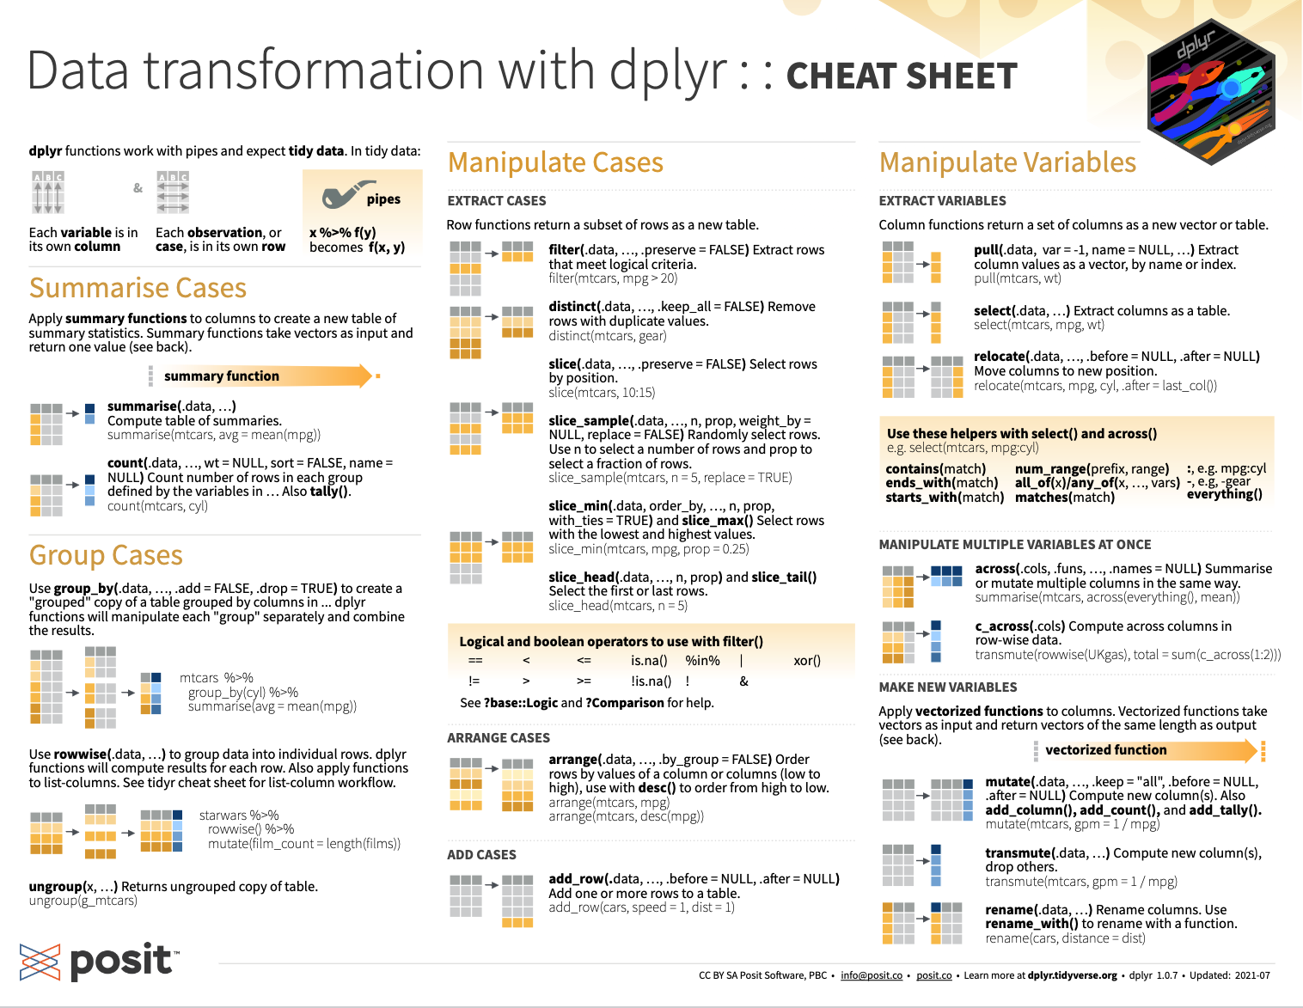
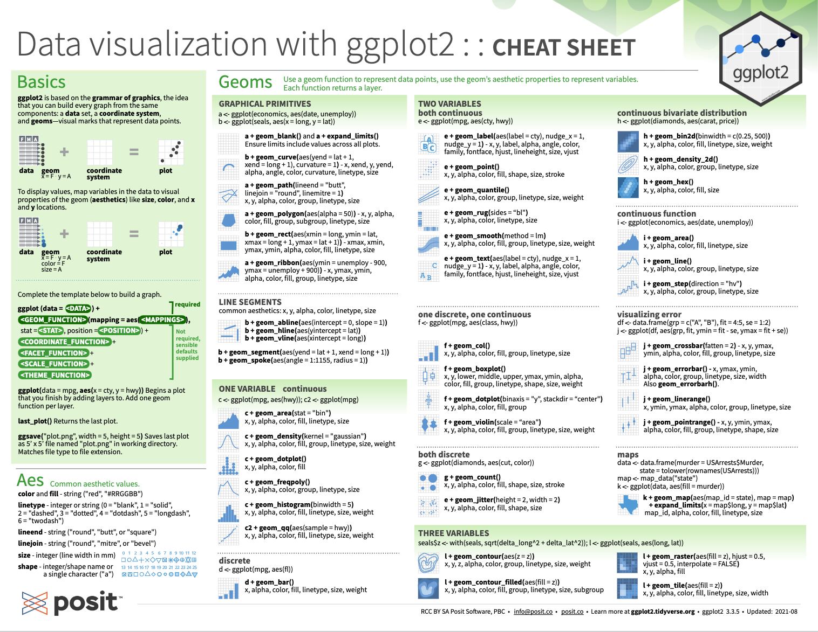
This is has been an General overview…
Working with the Tidyverse requires some mental adjustments… that are easier as you start your R-journey.
Multiple places with help → check this site https://bit.ly/412GGFW
Also, the Cheat-sheets created by Posit

Slide 38
So far so good?
Any questions?
Ready to continue?

Slide 39

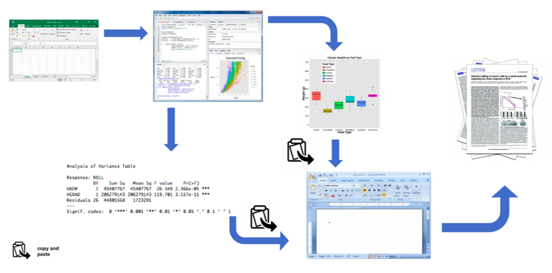


Reproducible reports Documenting Your work flow
This approach of click and point to document your work has some key pitfalls:
Not particularly reproducible.
Ineﬀicient and diﬀicult to maintain if your work in in progress.
Not clear what to share, or how to share it
Figure from Douglas et al (2020) Introduction to R

Slide 40

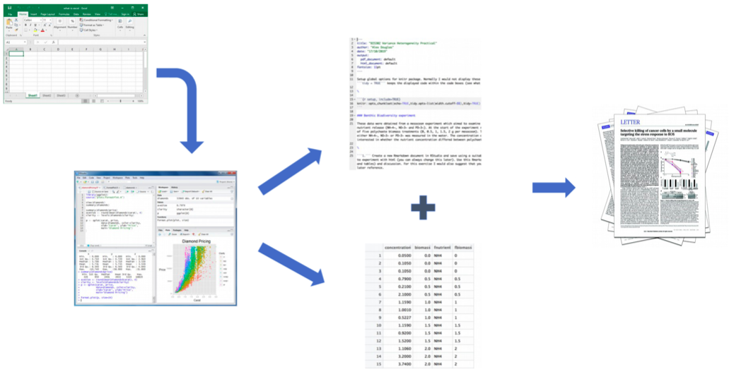
Reproducible reports Documenting Your work flow
Explicitly links your data with your R code and output creates a fully reproducible workflow that Enhances transparency of your research

Slide 41


Reproducible reports markdown or r-markdown
What is markdown?
It is a text-encoding language for creating
formatted text using a plain-text editor.
What is Rmarkdown?
R Markdown is an extension of the markdown
language used to embed within the formatted
text code and its output.

Slide 42
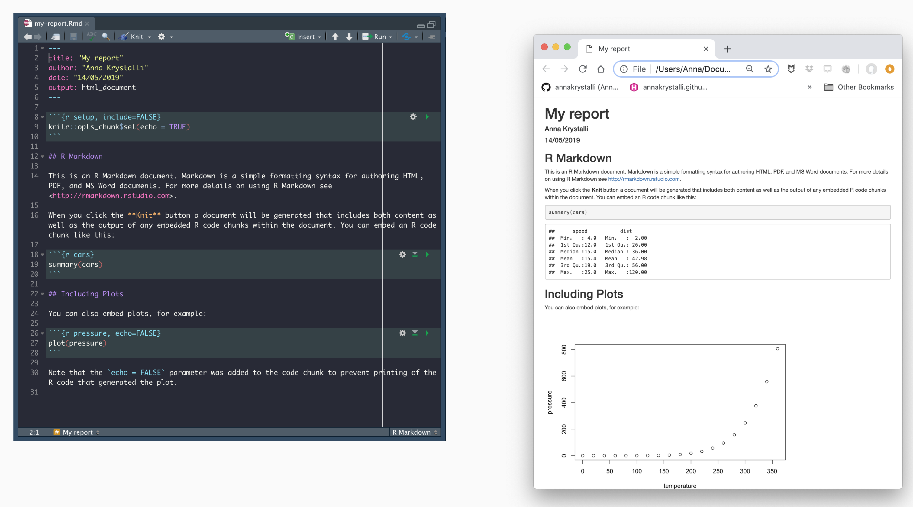
R markdown code
HTLM report

Slide 43
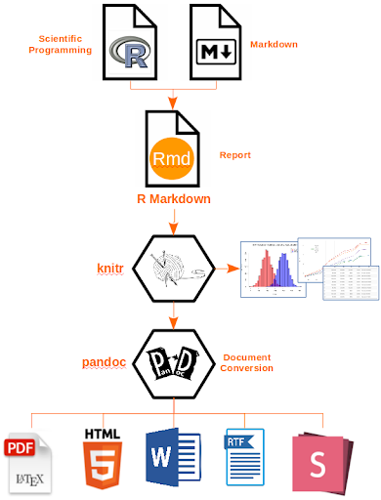
Documenting your Process Why R-markdown?
Provides a simple framework for data reporting.
Facilitates the reproducibility your work/research.
Encapsulates/documents your project workflow.
Transparency in experimental methodology, observation, collection of data and analytical methods.
Check out:
https://annakrystalli.me/talks/r-in-repro-research.html#20

Slide 44
Working with R-Markdown
You have been doing this for the last weeks – all your reports are R-markdown documents…
and we did a quick tour about how to create these in the first practical.
But lets do a quick recap before we get our hands dirty with more advanced functions.

Slide 45
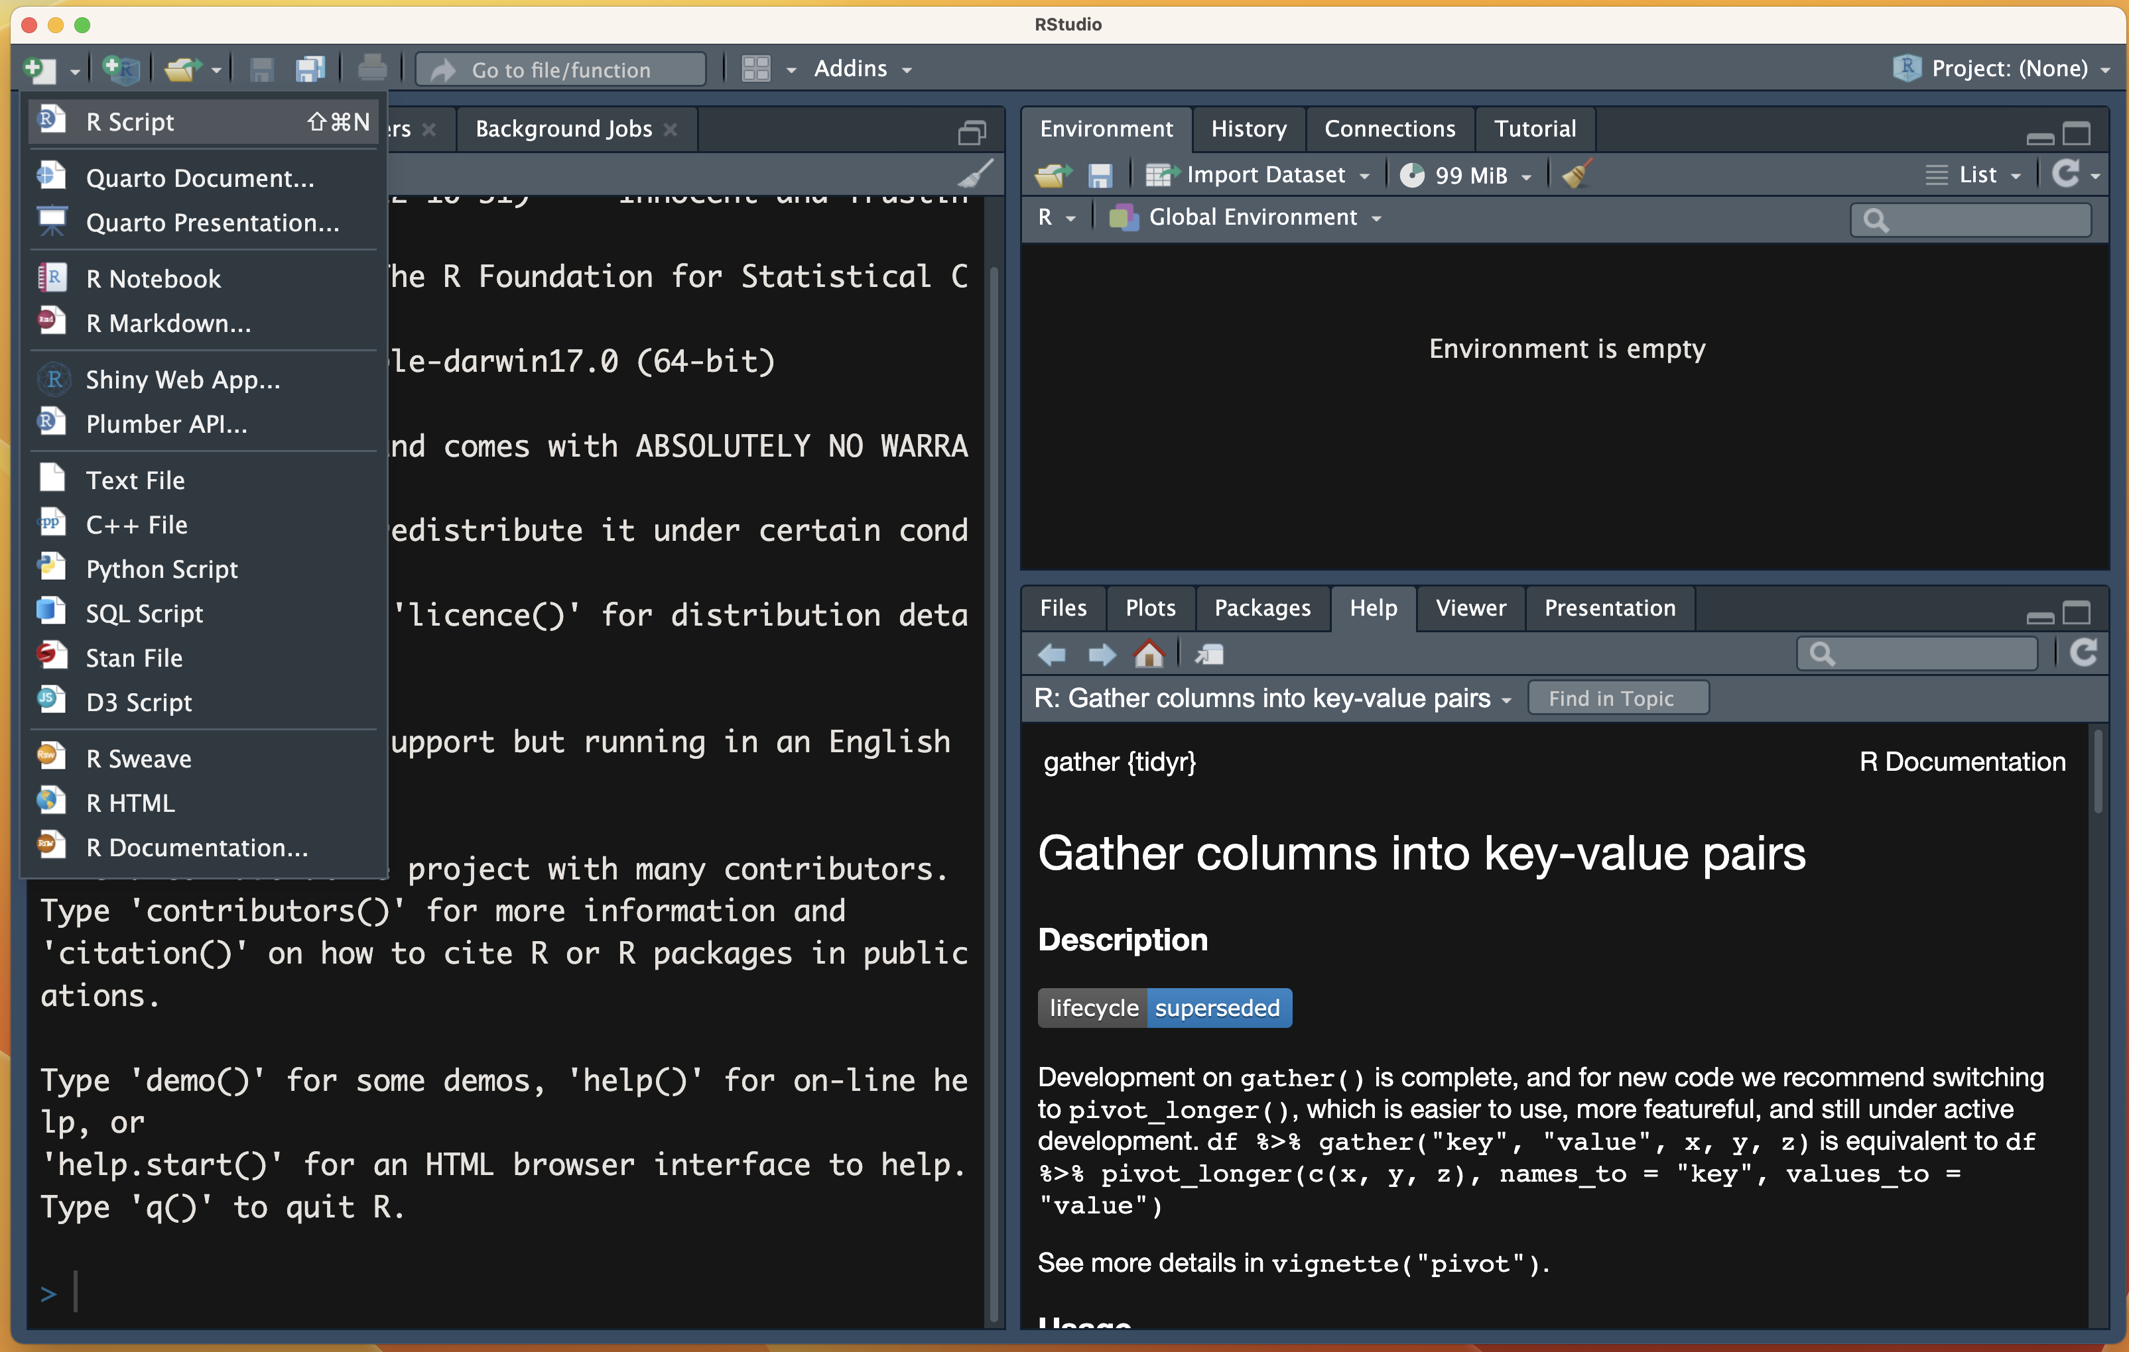
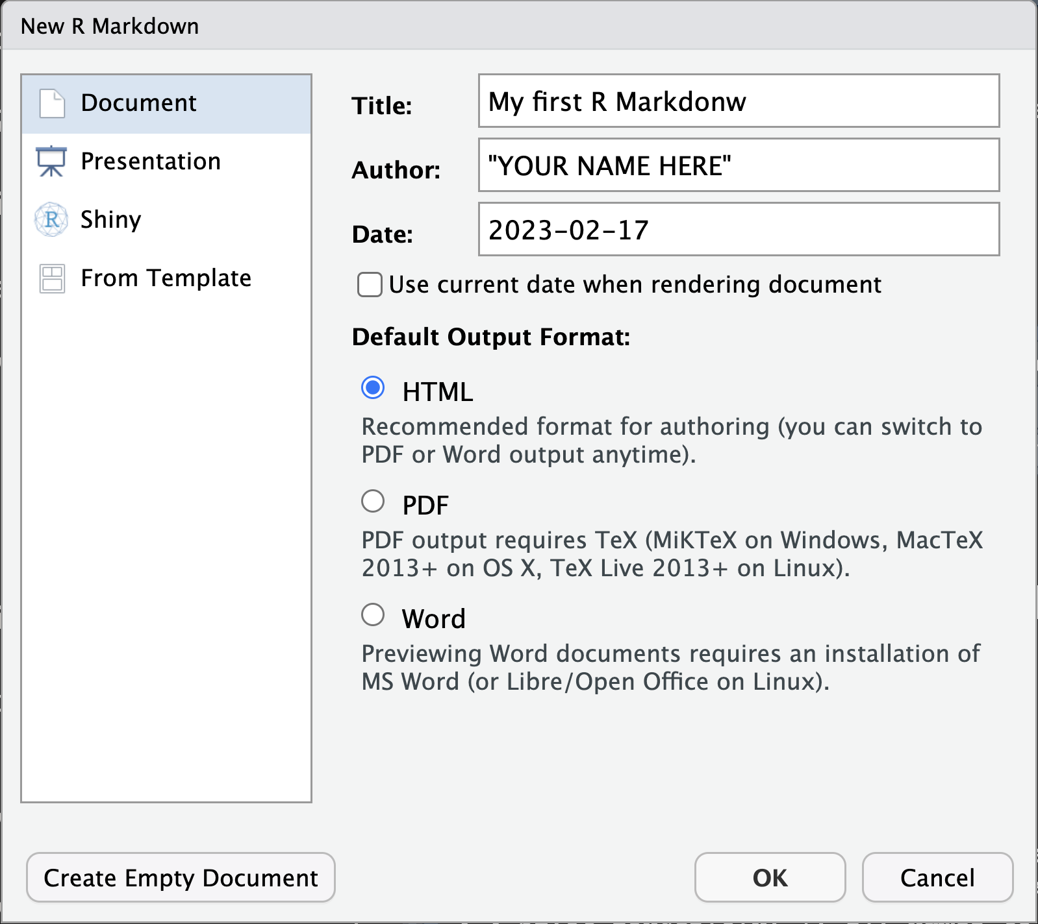
Create an R markdown document
Step 1.
Create a new file
Step 3.
Fill the basic info
Step 2.
Define it is a R Markdown
Step 4.
Define the output Format

Slide 46
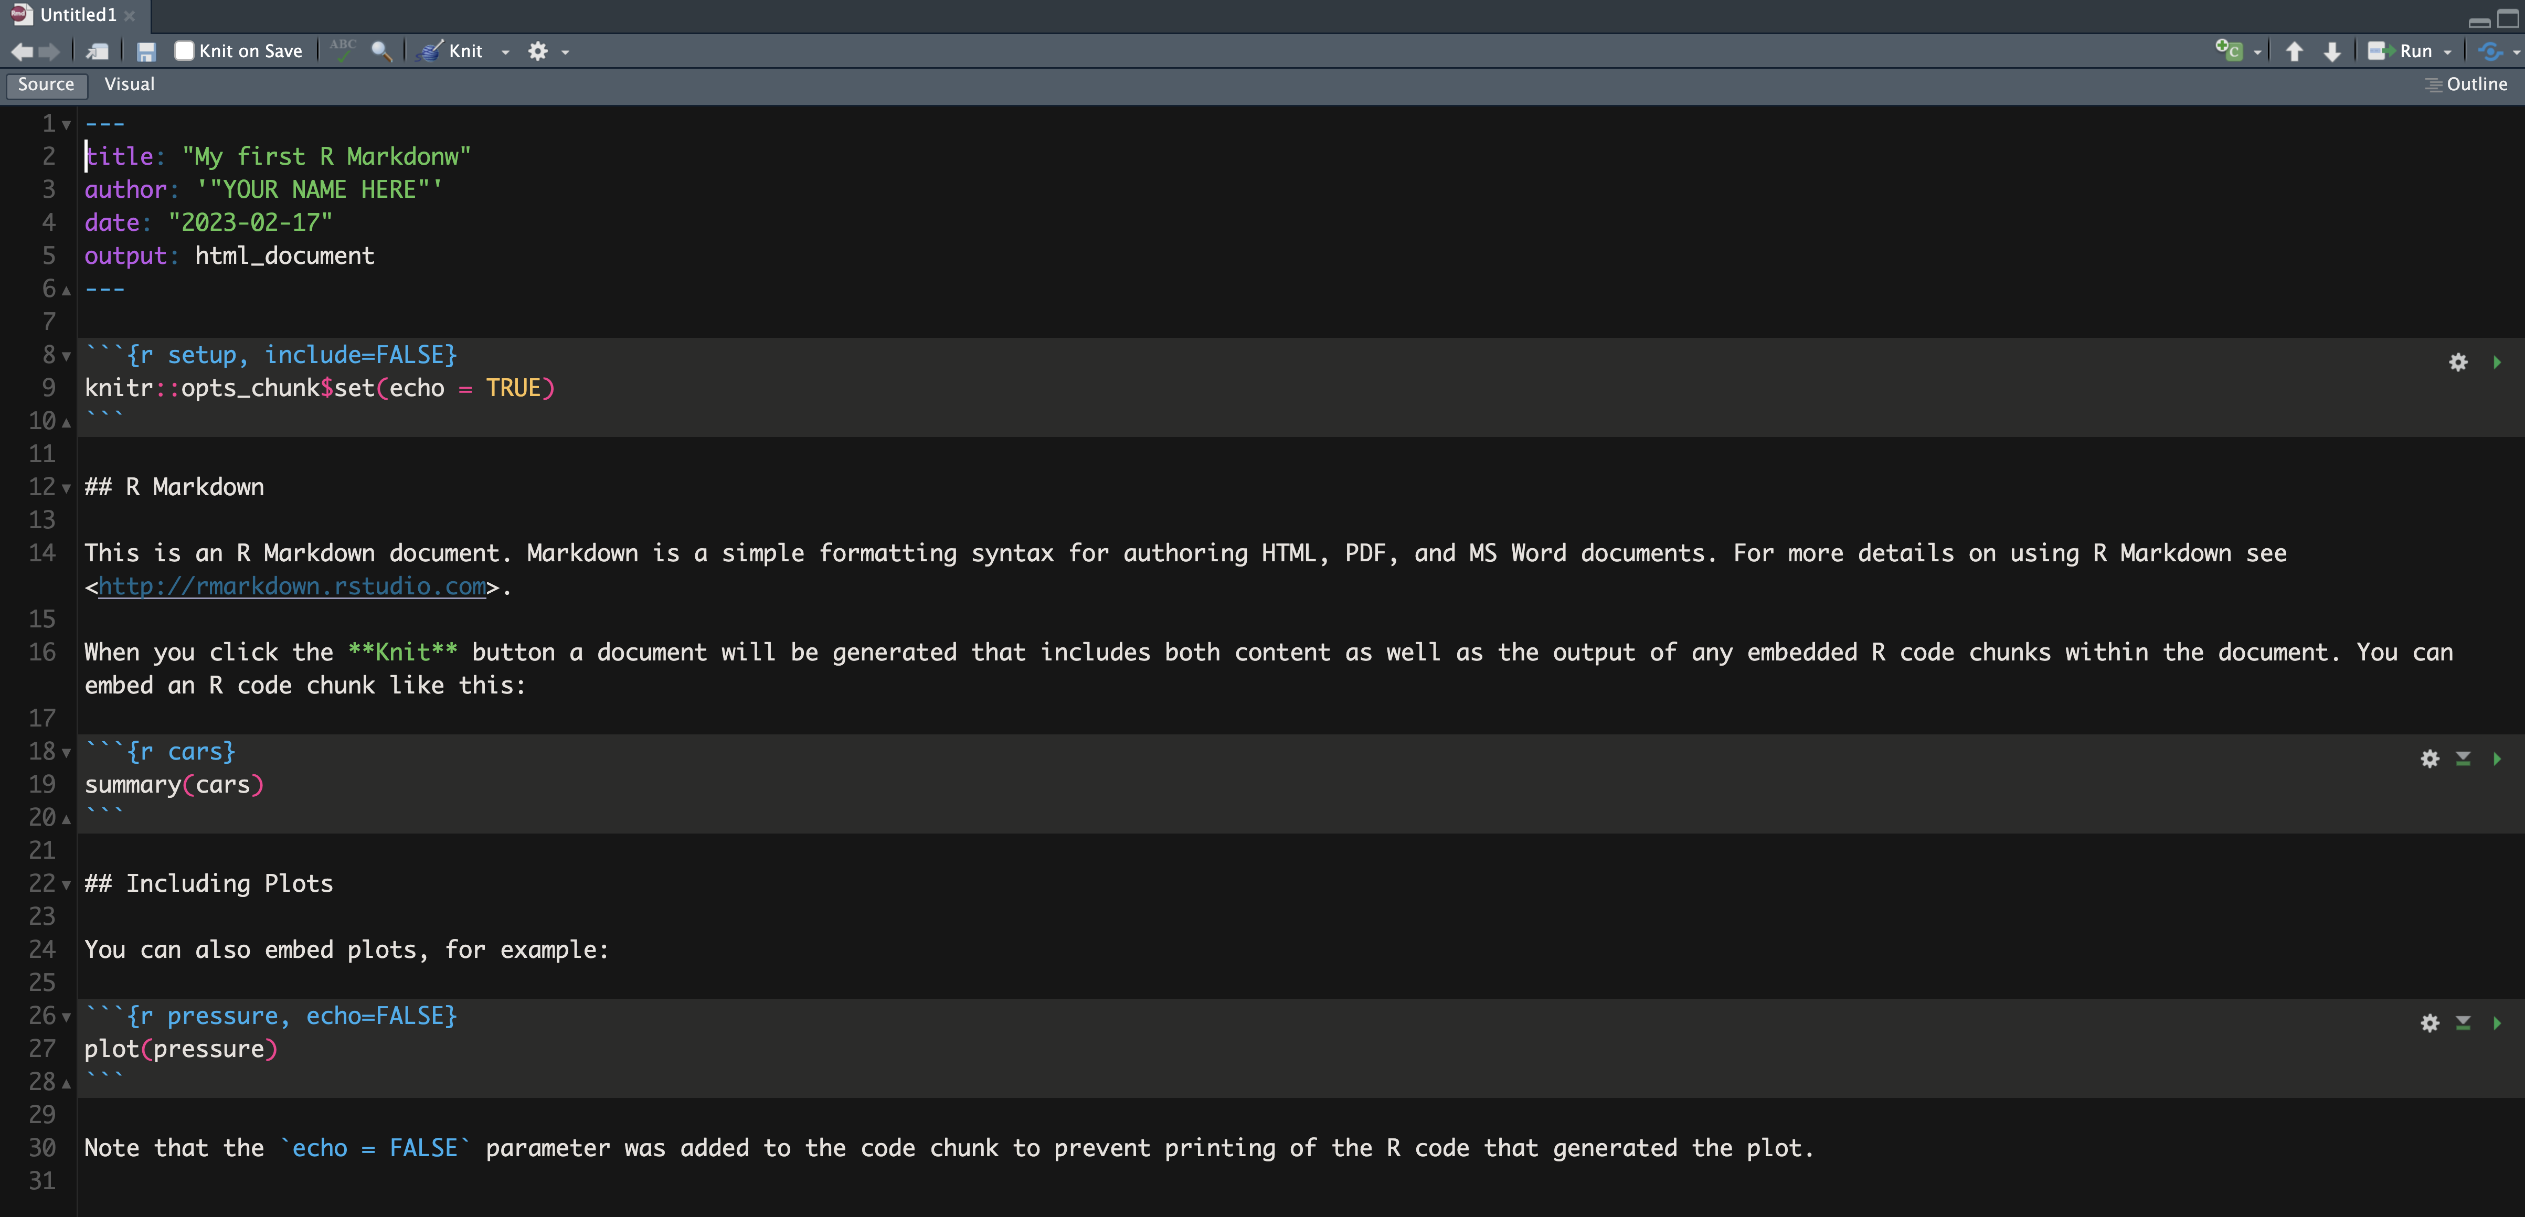
Create an R markdown document
YAML header
Setup chunk
Text
Code chunk

Slide 47
YAML header
A simple YAML header may look something like this:
---
title: My first R markdown document
author: Jane Doe
date: March 01, 2020
output: html_document
---
YAML stands for ‘YAML Ain’t Markup Language’ → for real!!
Contains the metadata (e.g., author name, date) and options (e.g., output format).
The YAML header is surrounded before and after by a three dashes (---) on its own line.
Could be expanded to include a TOC
---
title: My first R markdown document
author: Jane Doe
date: March 01, 2020
output:
html_document:
toc: yes
---

Slide 48
Formatted text
R markdown is able to render (almost) all of the text formatting that you are likely to need:
Header (#, ##, ###, …)
Italics (*TEXT*)
Bold (**TEXT**)
Strike-through (~~TEXT~~)
Super (^TEXT^) OR Subscript (~TEXT~)
Bulleted (*) and numbered (1. , 2., ) lists .
Images (![Legend](Path/(Path/file.png))
links to other documents or web pages ([TEXT](www.theplace.com))
Equations ($Area = \Pi*r^2$) → Based on LATEX syntax

Slide 49
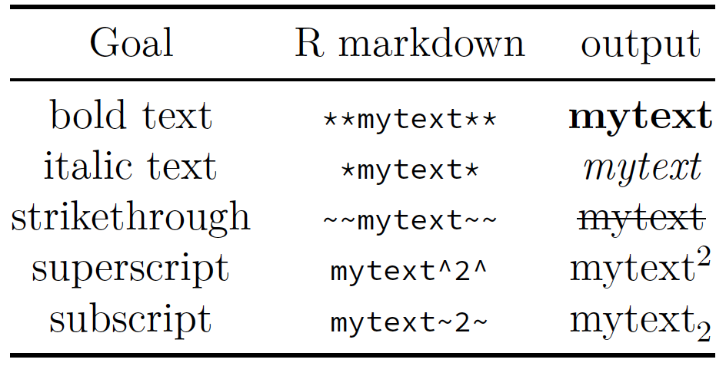
Formatted text

Slide 50
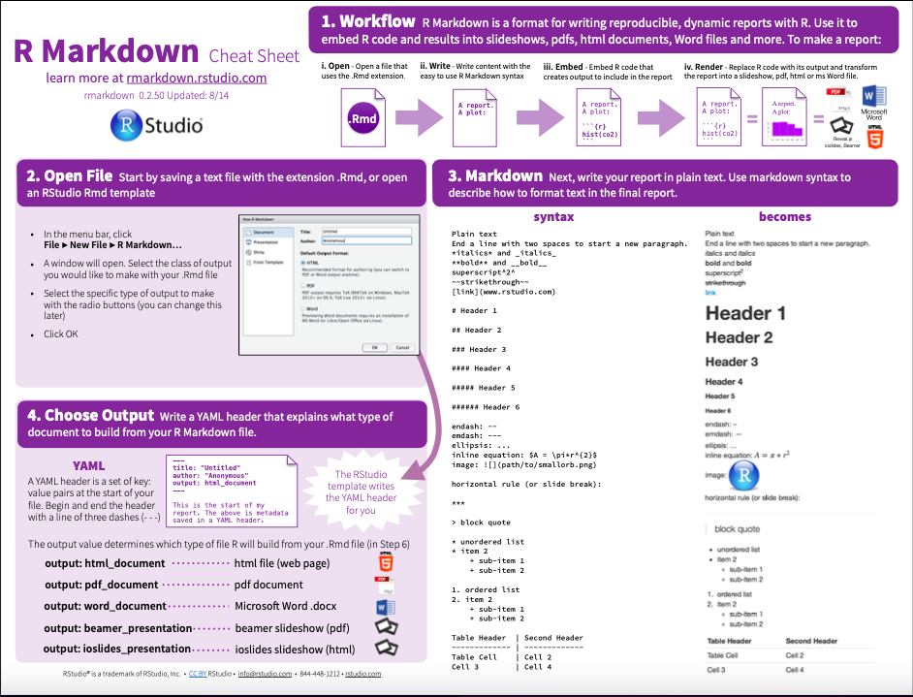
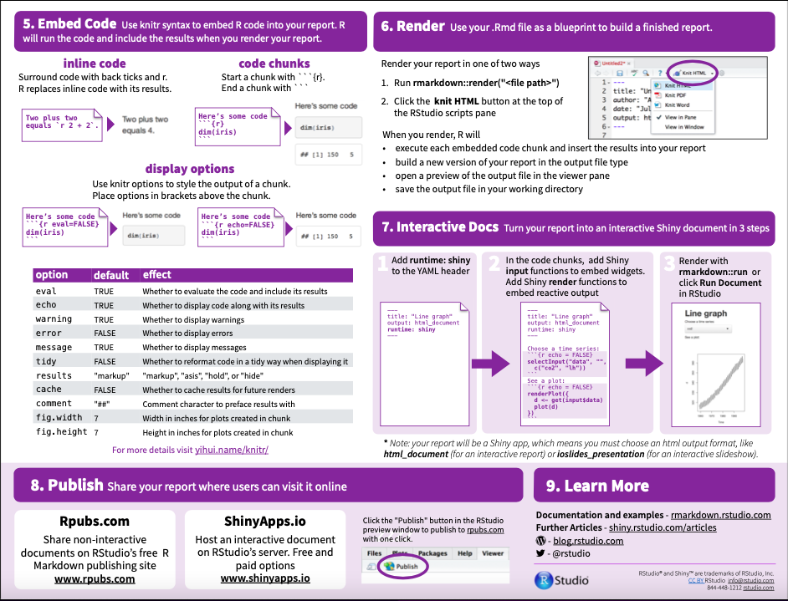
No need to remember everything

Slide 51

Let's do a Full example…
We will create a the R-Markdown where we will explore the Penguins dataset focusing on:
Defining the typical morphological variables.
Measure and visualize the variation of morphological variables.
Assess the covariation between morphological variables variables.
Establish how these trends change between different categorical variables.
So let’s go to the project:

Slide 52
Let’s setup this….
The basic Setup
title: "Exploring the penguins database"
author: '"YOUR NAME HERE"'
date: "`r Sys.Date()`"
output: html_document
But lets’ expand this:
Add table of contents that list headers 1 and 2
Define the editor options:
Output in console
Set the number of characters per line to 80
check https://rstudio.github.io/visual-markdown-editing/options.html

Slide 53
Adding some complexity…
The basic setup can be expanded to:
Include a table of contents that list headers 1 and 2
output:
html_document:
toc: yes → Add a Table of contents
toc_depth: 2 → Depth of headers
fig_caption: yes → Add caption to the figures
Define the editor options:
editor_options:
chunk_output_type: console → Output in console

Slide 54
Ok now Lets’ get some text
To start add the text below to your R-Markdown document describing the data:
This will make this text a header
## About the data.
Data were collected and made available by Dr. Kristen Gorman and the Palmer Station Antarctica LTER, a member of the Long Term Ecological Research Network.
The original `palmerpenguins` data contains morphological information on 244 individuals of three penguin species (152 individuals of Adelie penguins, 68 individuals of Gentoo penguins, and 124 individuals of Chinstrap penguins).

Slide 55
Now we can augment the text
You might want to add some hyperlinks to parts of your text:
These are done [TEXT](https://www.the website.com)
For example you want to provide hyperlink to the data provider…
[Dr. Kristen Gorman](https://www.uaf.edu/cfos/people/faculty/detail/kristen-gorman.php)
## About the data.
Data were collected and made available by [Dr. Kristen Gorman](https://www.uaf.edu/cfos/people/faculty/detail/kristen-gorman.php) and the Palmer Station Antarctica LTER,a member of the Long Term Ecological Research Network.

Slide 56
Your task….
Add a hyperlink for the the Palmer Station Antarctica LTER text ,marked in red below:
The link is https://pallter.marine.rutgers.edu/
## About the data.
Data were collected and made available by [Dr. Kristen Gorman](https://www.uaf.edu/cfos/people/faculty/detail/kristen-gorman.php) and the Palmer Station Antarctica LTER, a member of the Long Term Ecological Research Network.

Slide 57
Now let’s add a figure!
You can add Images to your r-markdown in two different ways:
In your free text
![LEGEND](Location in your HDD or Web)
Or a code chunk
```{r, echo=FALSE}
knitr::include_graphics(“Location in your HDD or Web”)
```

Slide 58
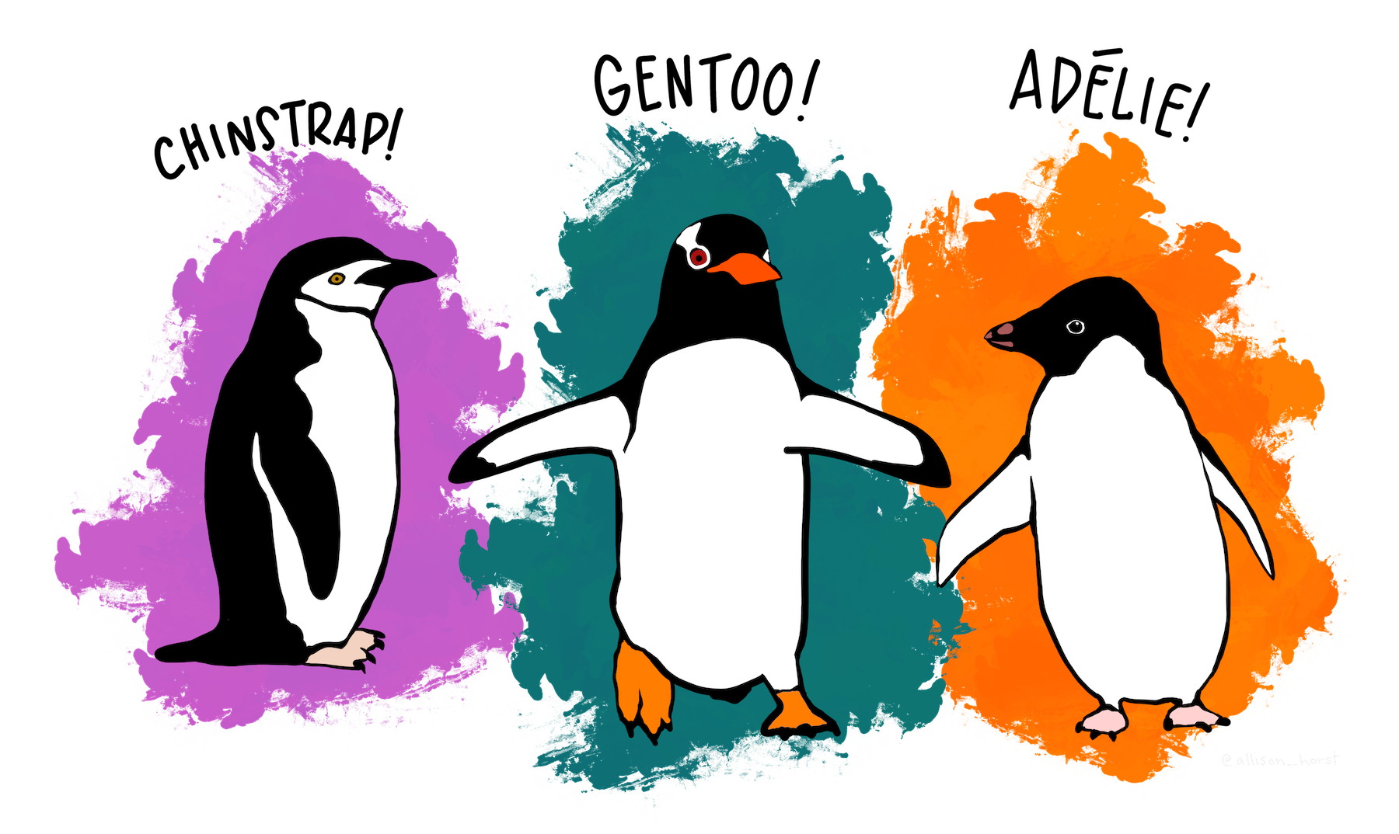
Your turn…
Now insert the great lter_penguins.png image created by @allison_horst for this dataset
![Meet the Palmer penguins - "Artwork by
@allison_horst"](lter_penguins.png)
OR
```{r, echo=FALSE}
knitr::include_graphics("./lter_penguins.png")
```
If you are up for a challenge, try to figure out how to change the size of the figure

Slide 59
Typical values of morphological variables
Ok now we can get to work and build a descriptive statistics table for the morphological variables (bill_length_mm, bill_depth_mm, flipper_length_mm, body_mass_g) in the penguins dataset.
Now do this using the summarise()/ summarise_at()

Slide 60
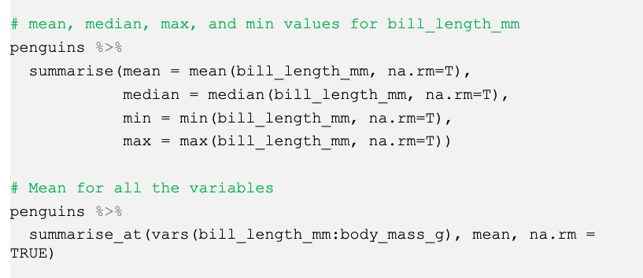
Typical values of morphological variables

Slide 61
Typical values of morphological variables
# mean, median, max, and min values for bill_length_mm
penguins %>%
summarise(mean = mean(bill_length_mm, na.rm=T),
median = median(bill_length_mm, na.rm=T),
min = min(bill_length_mm, na.rm=T),
max = max(bill_length_mm, na.rm=T))
# Mean for all the variables
penguins %>%
summarise_at(vars(bill_length_mm:body_mass_g), mean, na.rm = TRUE)

Slide 62
Typical values of morphological variables
You have the values now, but how to print them in a table?
using native markdown syntax
| Variable | bill_length_mm | bill_depth_mm | flipper_length_mm | body_mass_g |
|----------|----------------|---------------|-------------------|-------------|
| Min | 32.10 | 13.10 | 172.00 | 2700.00 |
| Mean | 43.92 | 17.15 | 200.92 | 4201.75 |
| Median | 44.45 | 17.30 | 197.00 | 4050.00 |
| Max | 59.60 | 21.50 | 231.00 | 6300.00
Call it in a R chunk
```{r, ugly-table}
TableSummDtfrm
```
Call it in a R chunk
```{r, kable-table}
knitr::kable(TableSummDtfrm)
```

Slide 63
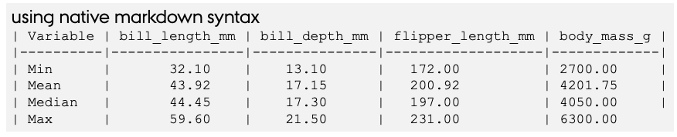
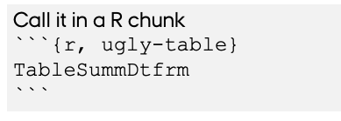
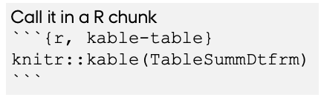
Typical values of morphological variables
You have the values now, but how to print them in a table?

Slide 64
Calling R code in the free text
You have the values now, but how to add them in the text?
R outputs can be call within the free text area specifying it as `r object`.
For example:
The min bill length (in mm) is` r TableSummDtfrm[1,1]` and the max is bill length (in mm) is ` r TableSummDtfrm[1,4]`
Returns
From this we know how that the min bill length (in mm) is 32.1 and the max is bill length (in mm) is 2700.

Slide 65
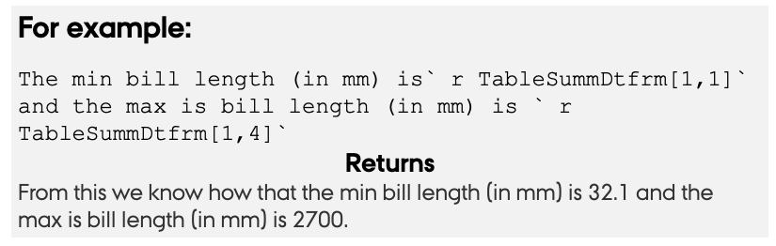
Calling R code in the free text
You have the values now, but how to add them in the text?
R outputs can be call within the free text area specifying it as `r object`.

Slide 66
Variation of morphological variables
In this section you will see how to add graphical outputs in your R-markdown document
You will here plot a histogram for the morphological variables (bill_length_mm, bill_depth_mm, flipper_length_mm, body_mass_g) in the penguins dataset.
You will use the geom_histogram() function.

Slide 67
covariation between variables variables
You can add legend, change the plot dimensions, and alignment
```{r, fig.cap=”LEGEND",
fig.width=4, fig.height=3,
fig.align='center'}
```{r}
# Histogram All Species
penguins %>%
drop_na(bill_depth_mm) %>%
ggplot(aes(x=bill_depth_mm)) +
geom_histogram( color="blue",
fill = "blue",
alpha=0.6,
position = 'identity’)
```

Slide 68
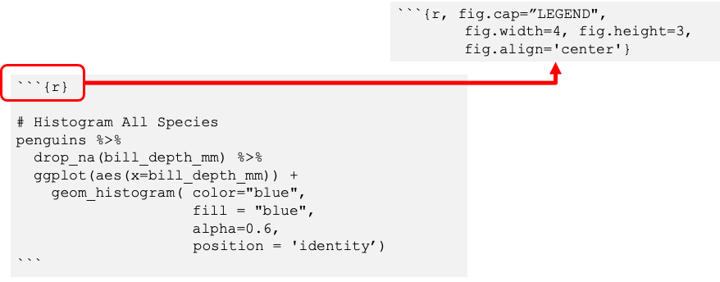
Variation of morphological variables
You can add legend, change the plot dimensions, and alignment

Slide 69
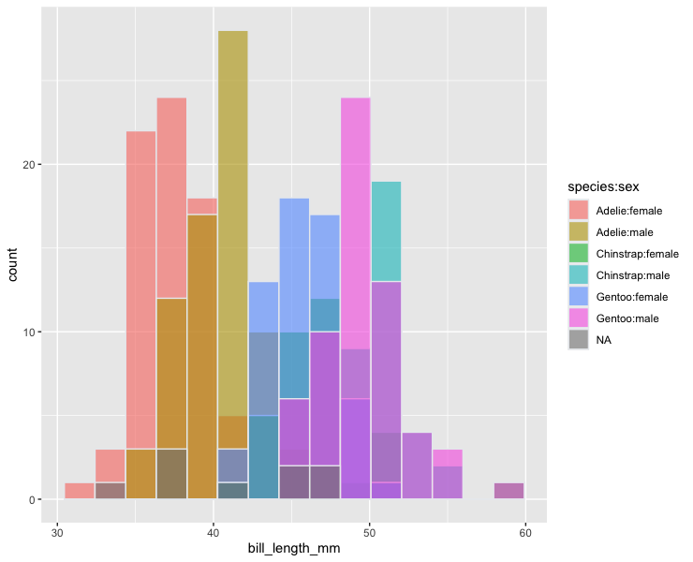
What about categorical factors
# Histogram per Species x Sex
penguins %>%
drop_na(bill_depth_mm) %>%
ggplot( aes(x=bill_length_mm,
fill=species:sex,
na.rm = TRUE)) +
geom_histogram(color="#e9ecef",
alpha=0.6,
bins = 15,
position = 'identity')
A Challenge:
Try to make this figure so you have a panel per species

Slide 70
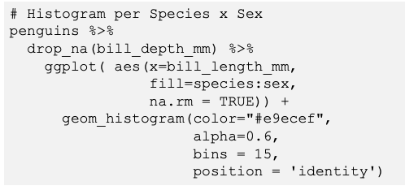
What about categorical factors
A Challenge:
Try to make this figure so you have a panel per species

Slide 71
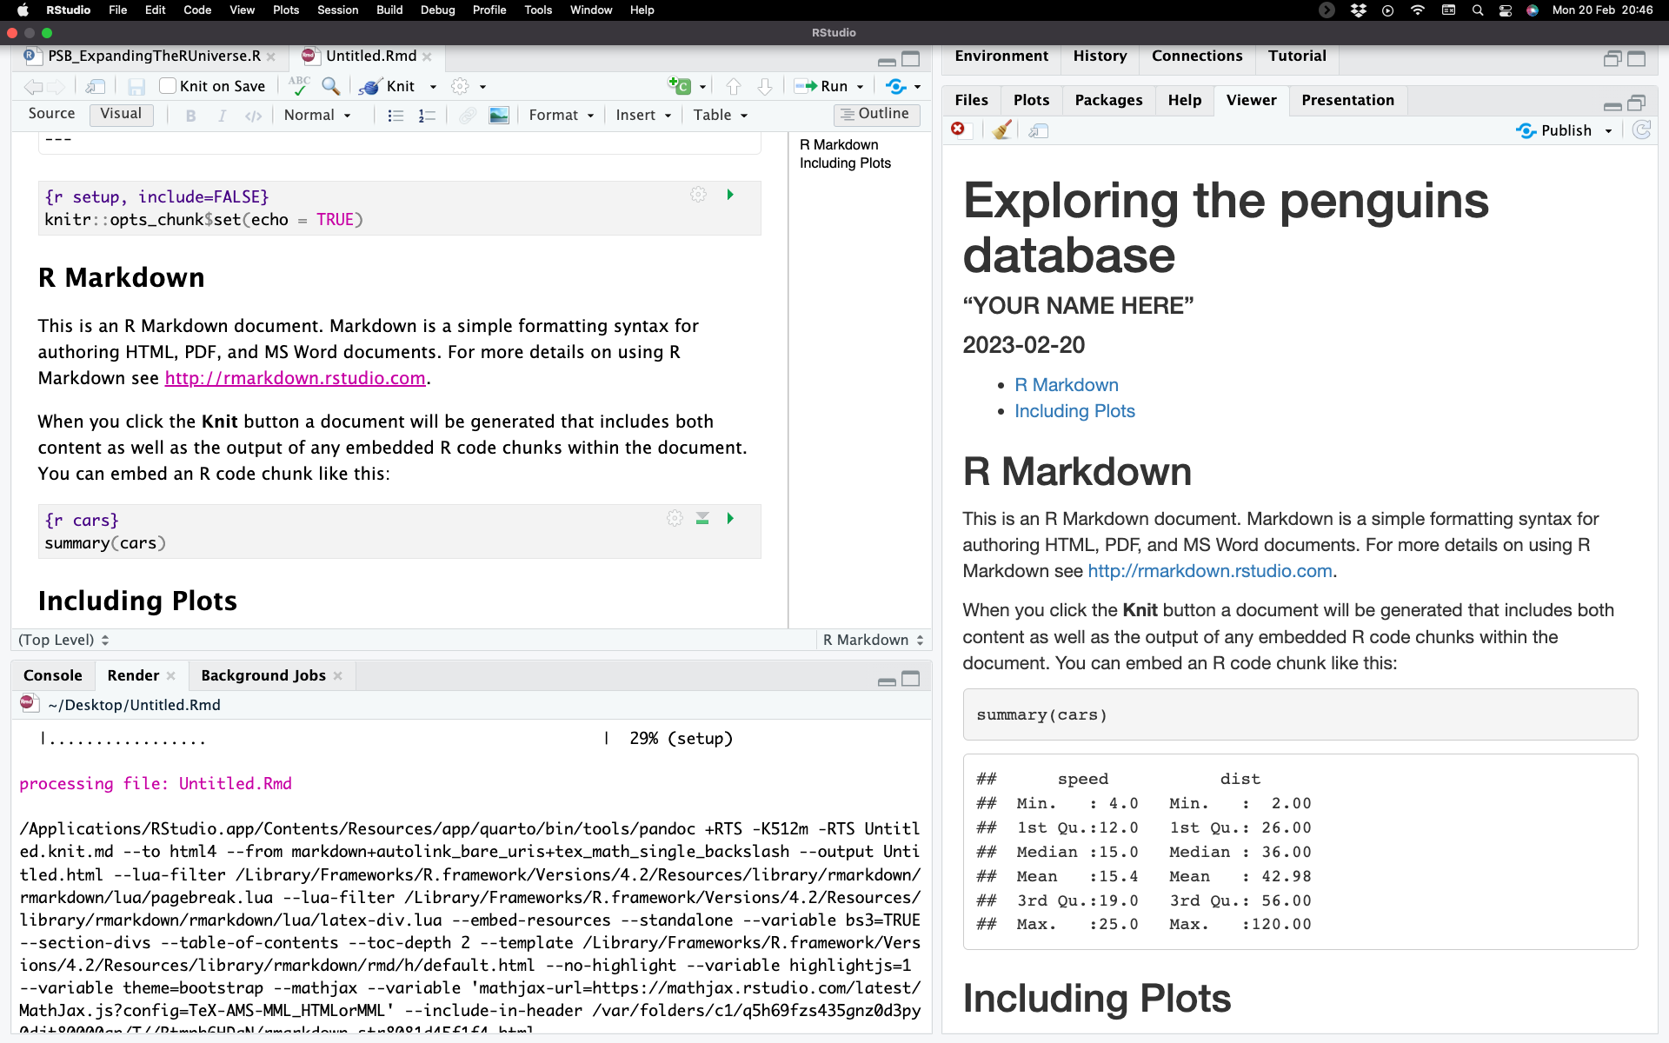
Visual R Markdown
RStudio v1.4 includes a new visual markdown editing mode
Gets the markdown experience closer to that of a text editor
https://rstudio.github.io/visual-markdown-editing/

Slide 72


Beyond R-markdonw Jupyter notebooks & Quatro
There two are language agnostic platforms that can be used to generate summaries of your work

Slide 73
Beyond R-markdonw Jupyter notebooks
Web-based for notebooks, code, and data that allows users to configure and arrange workflows.
These can be transformed into secure, stand-alone web applications that you can customize and share

Slide 74
Beyond R-markdonw Quatro
Like Jupyter Notebooks, it allows a combination of code, and data that allows users to configure and arrange workflows.
This is the Evolution of R-markdown so it follows the same rules are R-markdown

Slide 75
So far so good?
Any questions?
Ready to continue?

Slide 76
Version control with Git and GitHub
What is version control?: keeping a record of all the changes you make to your files that make up a particular project and allows you to revert to previous versions of files if you need to.
Many different version control systems currently available
We focus on Git, because it’s free and open source and it integrates nicely with RStudio.

Slide 77
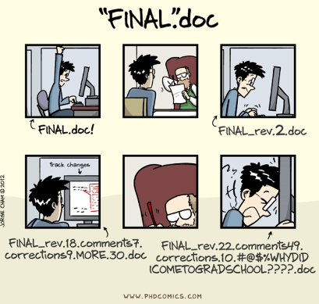
Why use version control?
Version control automatically takes care of keeping a record of all the versions of a
particular file and allows you to revert back to previous versions if you need to.

Slide 78
What is Git and GitHub?
Git is a version control system that lets you track changes on any type of file, specially those that typically make up a data orientated project (.pdf, .Rmd, .docx, .txt, .jpg etc)
All the files that make up a project is called a repository (or just repo).
GitHub is a web-based hosting service for Git repositories which allows you to create a remote copy of your local version-controlled project.
This can be used as a backup or archive of your project or make it accessible to you and to your colleagues so you can work collaboratively.

Slide 79
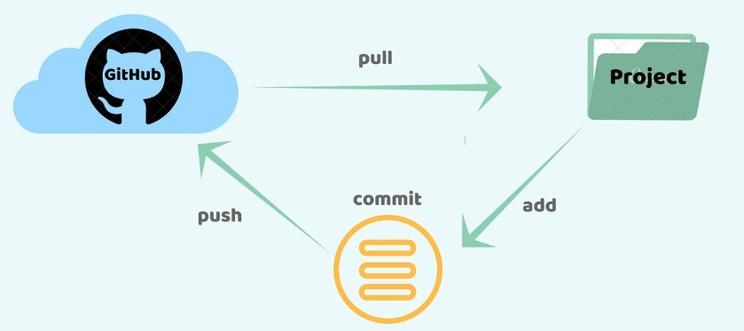
the git mantra: Pull, commit, push.

Slide 80
the git mantra: Pull, commit, push.
Pull - a pull grabs any changes from the GitHub repository and merges them into your local repository.
Commit - committing is the process which records changes in the repository. Think of it as a snapshot of the current status of the project. Commits are done locally.
Push - pushing sends the recent commit history from your local repository up to GitHub.

Slide 81

Let’s open a github account!
Go to https://github.com/
And sign up

Slide 82
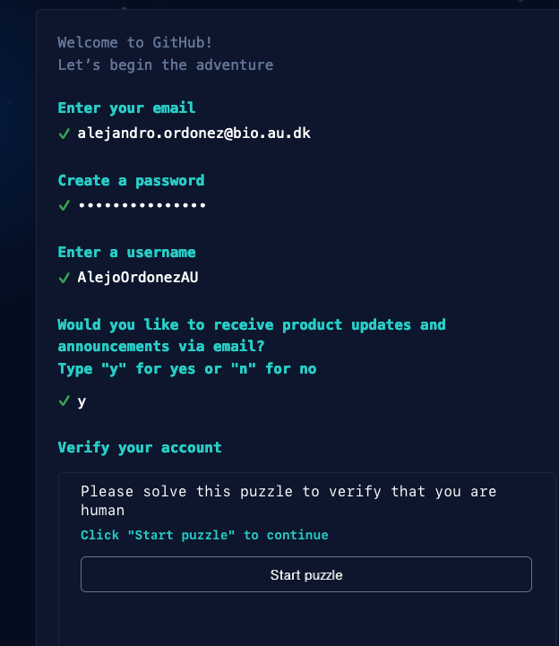
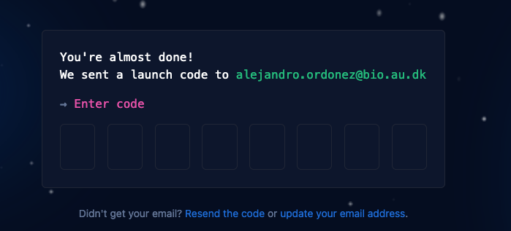
Let’s open a github account!
Fill your details…
… and authenticate your account

Slide 83
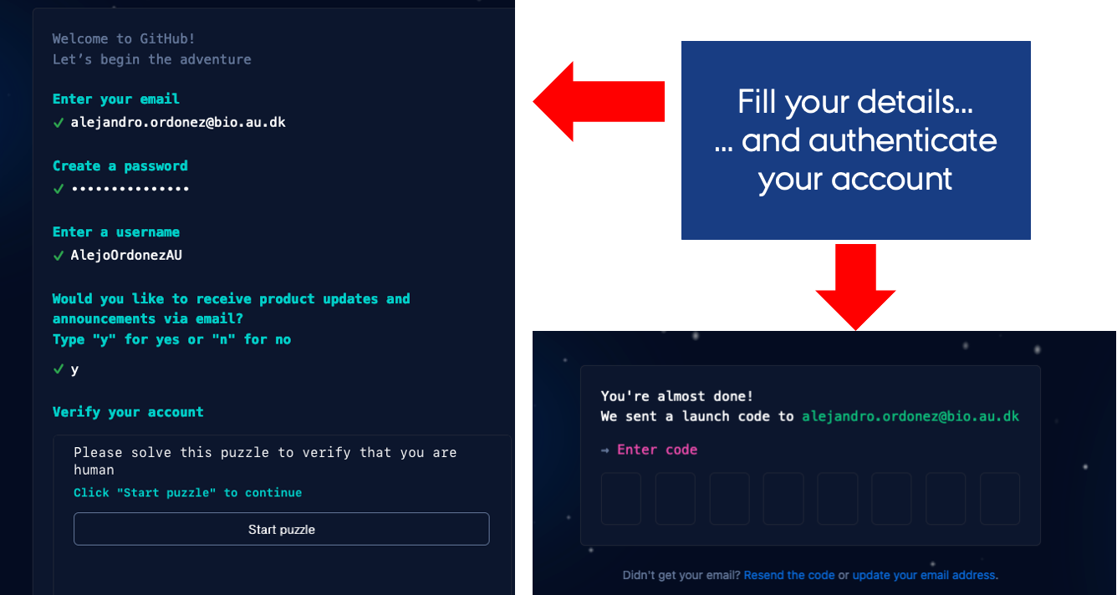
Let’s open a github account!
GitHub asks you some questions to help tailor your experience.
Choose the answers that apply to you in the following dialogs:
How many team members will be working with you?
What specific features are you interested in using?
On the Where teams collaborate and ship screen, choose the Free account or the Team account and select the Skip personalization button.

Slide 84
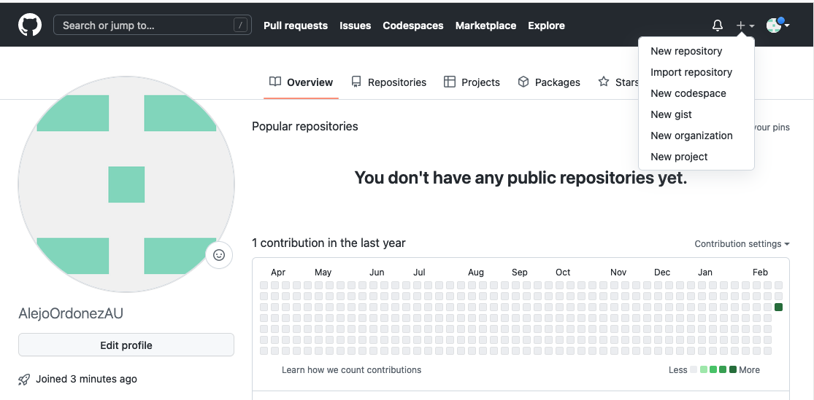
Now lets get stuff In It
To start lets create a new REPO Named PSB_2023

Slide 85
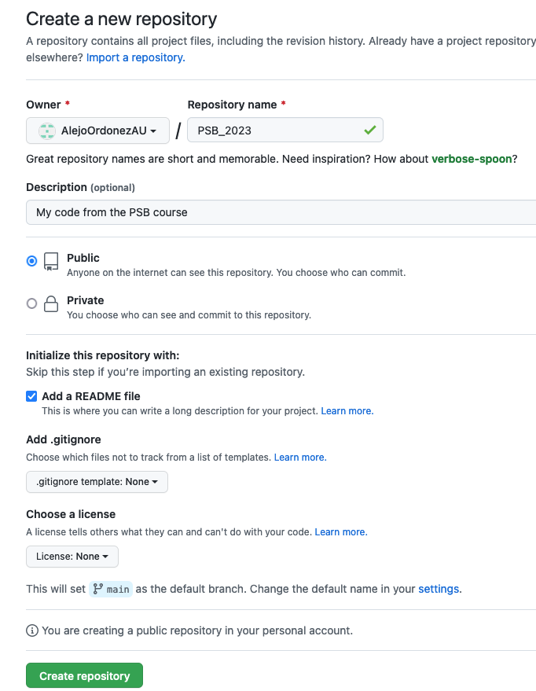
Now lets create a REPO
To start lets create a new REPO Named PSB_2023
Name
Description
Make it Public
Add a Readme
Don’t worry about this
For now
Now you can create your REPO

Slide 86
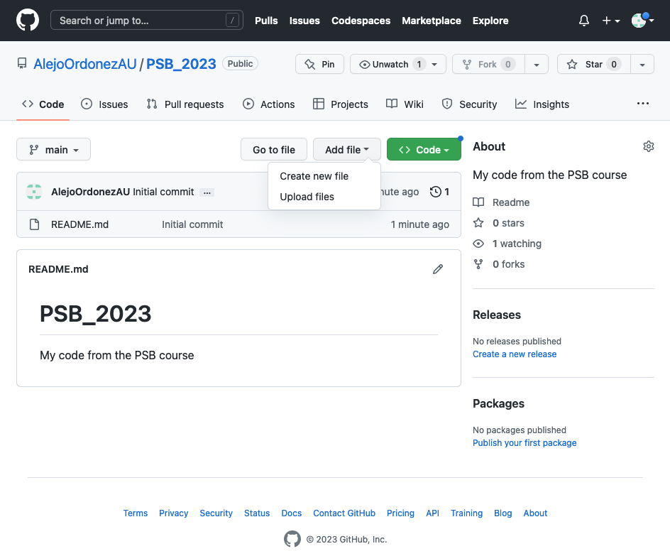
Now lets get stuff In It
Create a file
Upload your code

Slide 87
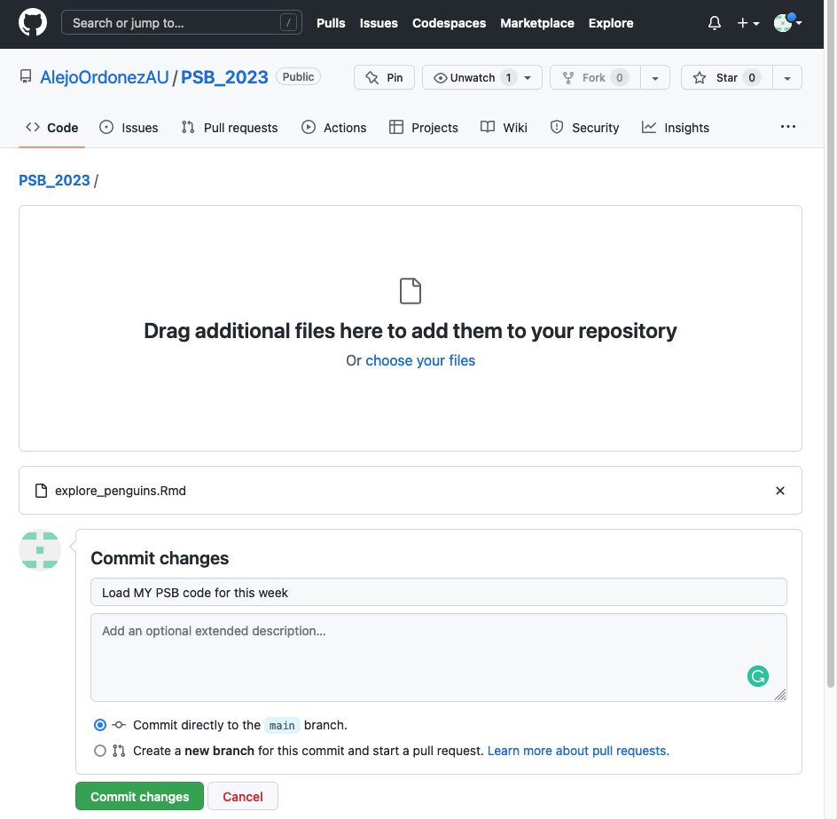
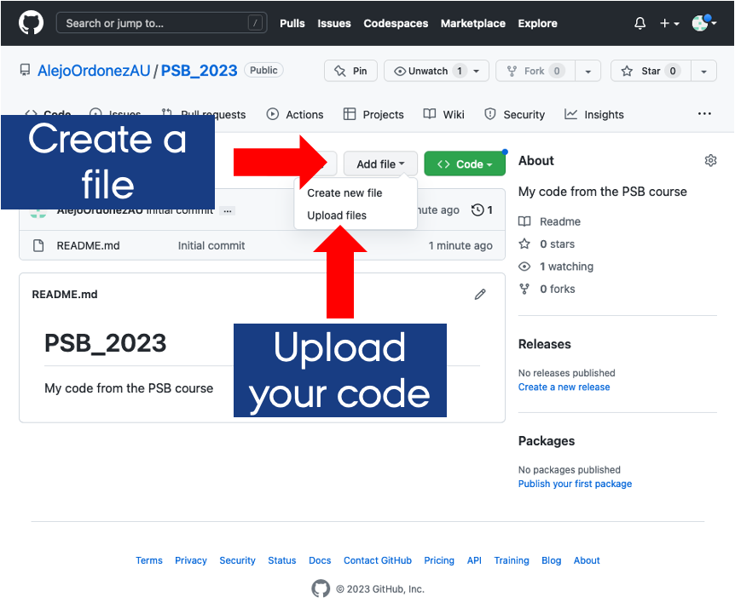
Now lets get stuff In It
Upload your code
By dragging it here
And it will appear here
Describe your file
Commit your change

Slide 88


You have created your first REPO
And it will appear here

Slide 89
RStudio projects – the what?
RStudio projects make it straightforward to divide your work into multiple contexts, each with their own working directory, workspace, history, and source documents.
RStudio projects can be seen and a full copy of your environment , that you can always go back to as they keep all the files associated with a project together.
RStudio projects can be linked to a Git-Repo so you can have an online backup of your work.

Slide 90




RStudio projects – the how?
Press here to create a new project

Slide 91


RStudio projects – the how?
Define the Version control system
You can link your project to a repo so you can keep versioning it as you work on it
Then you git it the repo details

Slide 92

Now you are working on a project
All your Git actions are here
All the files related to the project are here

Slide 93
So far so good?
Any questions?
Ready to finish?

Slide 94
Summary
The tidyverse provides a data centred set of functions (verbs) that are extremely useful for data sciences…
Master dplyer and ggplot2 and become a R-ninja!!
Even the best annotated code, can be hard to go back to… hence crating reports that fully describe your thought process is the best way to ensure reproducibility.
The best way to keep track of your work is to create a project and use a version control system.

